Slide 1

Antisemitism on Twitter
Teaching Students How to Analyze Online Hate Through
A Simple Information Literacy Assignment
https://bit.ly/2xouTG0
Melanie Hubbard, DS Librarian
Loyola Marymount University
Notes:
I’m going to talk about an assignment I designed in Spring 2017 for a history of antisemitism class taught by Dr. Margarete Feinstein, LMU professor of Jewish Studies. The assignment involved students (who worked in pairs) doing research on, writing a paper on and presenting on a single antisemetic tweet. (Each pair had a different tweet.)
Helpful source: https://www.adl.org/resources/reports/quantifying-hate-a-year-of-anti-semitism-on-twitter#introduction

Slide 2
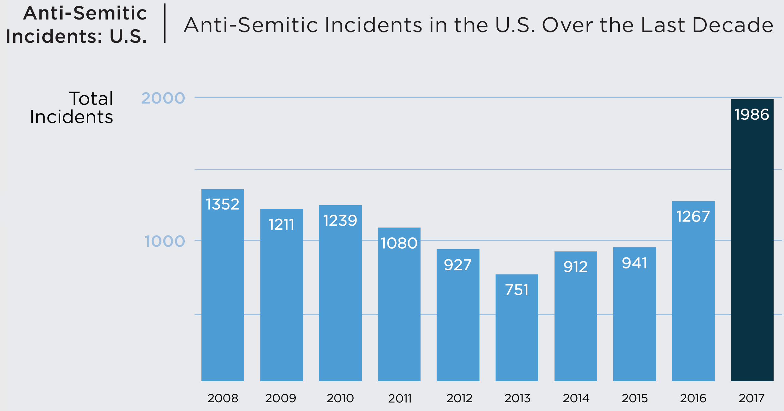
ADL 2017 Audit of Anti-Semitic Incidents
Notes:
The relevance of this kind of assignment may be obvious, but nonetheless I would like to point out a few statistics. In the US antisemitic incidents rose 57 percent in 2017…
See report: https://www.adl.org/resources/reports/2017-audit-of-anti-semitic-incidents

Slide 3
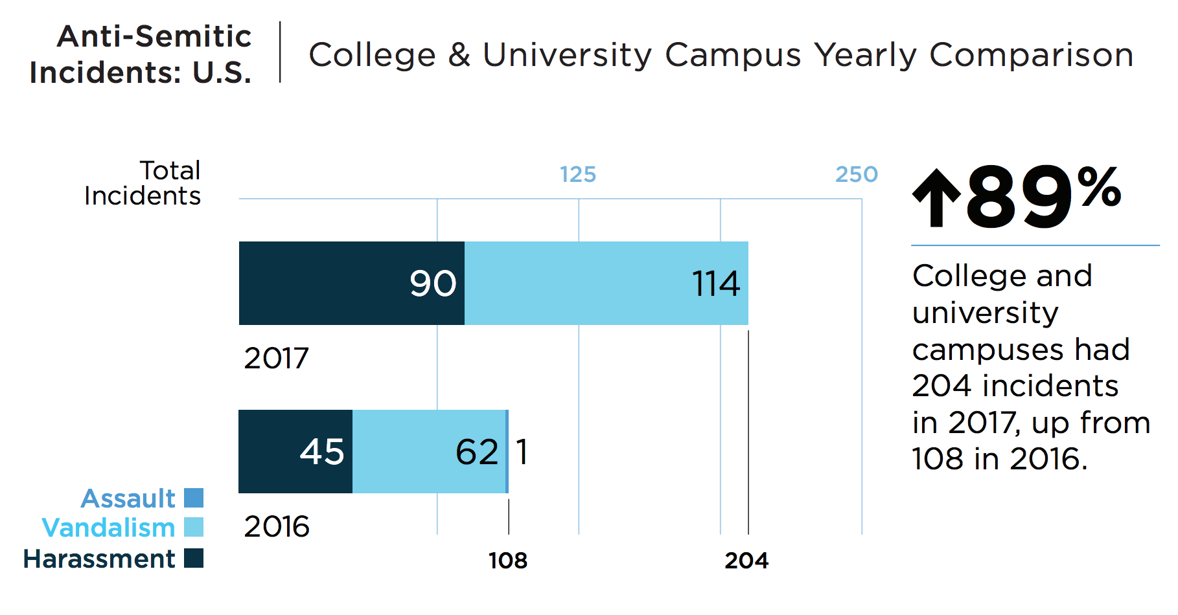
ADL 2017 Audit of Anti-Semitic Incidents
Notes:
…and such incidents rose 89% on college and university campuses.
See report: https://www.adl.org/resources/reports/2017-audit-of-anti-semitic-incidents

Slide 4
The Assignment
(offensive images to follow)
Notes:
When designing I dived into twitter to look at the landscape. Very quickly I could see how hideous and insidious it is. To find relevant tweets I used basic search terms, many of which were hate speech. I searched hash tags, and I searched using emojis—which the alt-right often use to signify their ideology.
Based on what I found, it was clear that we should not send the students into twitter to find their own tweets. First and foremost, we were concerned about their emotional well-being.
There also needed to be criteria for what tweets were selected--there needed to be enough levels to the tweets and the tweets needed to be, as much as possible, equal in complexity.
By “levels” I mean multiple ways into the tweet. The criteria I chose was that the tweet had to have something significant about the sender and/or receiver and there had to be a meme. The inclusion of the meme was intended to add a visual literacy component. It was also included because so much of antisemitism is communicated through visual means.

Slide 5
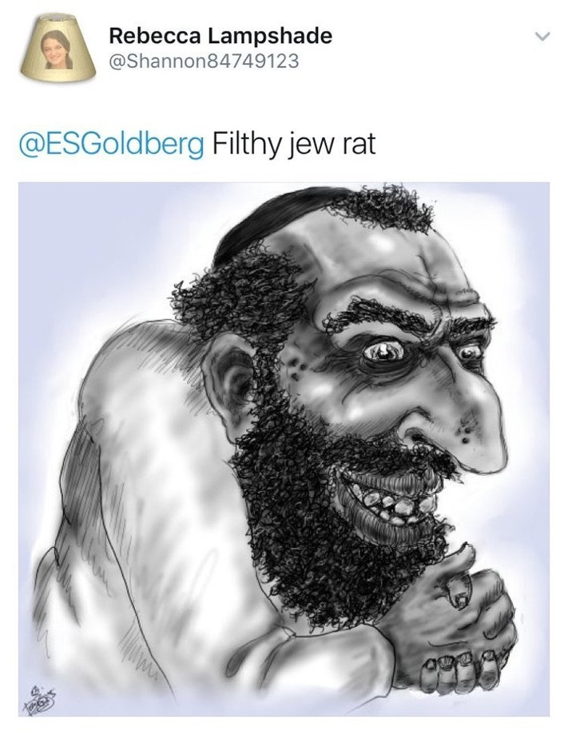
Sender
Holocaust reference
Recipient
Eleanor Goldberg,
Business Reporter,
Huffington Post
“Happy Merchant” caricature Originally drawn by A. Wyatt Mann (Nick Bougas)
Image/Meme
Assignment Design: Tweet Selection Criteria
Notes:
Tweet example

Slide 6
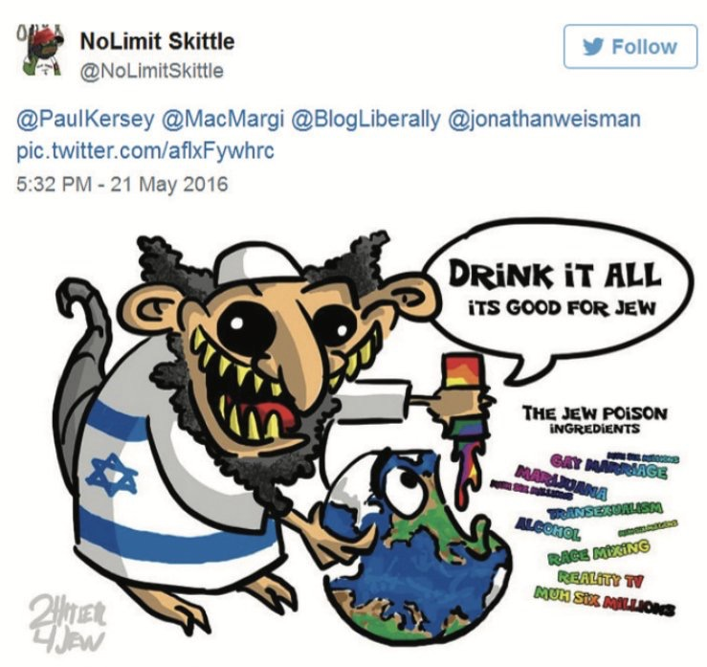
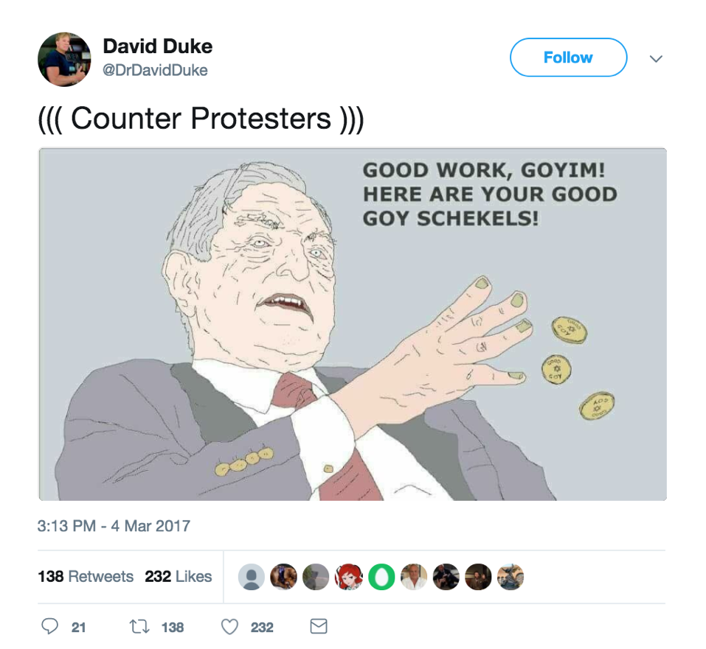
Assignment Design: Tweet Examples
Notes:
Tweet examples

Slide 7
1.) Who sent the tweet and/or received the tweet?
2.) What is the context of the tweet being sent?
3.) Why do you think antisemitism images and language are being used? Is to simply insult, to intimidate or threaten, to hurt someone’s reputation, etc.?
4.) What antisemitic trope(s) does the tweet evoke?
5.) How does the use of trope(s) in the tweet connect with the trope’s use throughout history?
6.) Beyond the trope, is there any other part of the tweet that is antisemitic, for example, the sender's twitter handle (name) or picture?
7.) What is significant about antisemitism being expressed on social media? How is it similar to and different from publishing books like The Protocols of the Elders of Zion?
Assignment Design: Prompt Questions
Notes:
The assignment instructions included a prompt that encouraged students to ask questions about their tweets like… (see slide)
When first presenting the assignment, we went through all of the tweets together. The reason being, I wanted to help the students (and have them help each other) begin the brainstorming process—how would they start to research and analyze this image or that text?—and I didn’t want them to be on their own for their first encounter with the tweets.

Slide 8
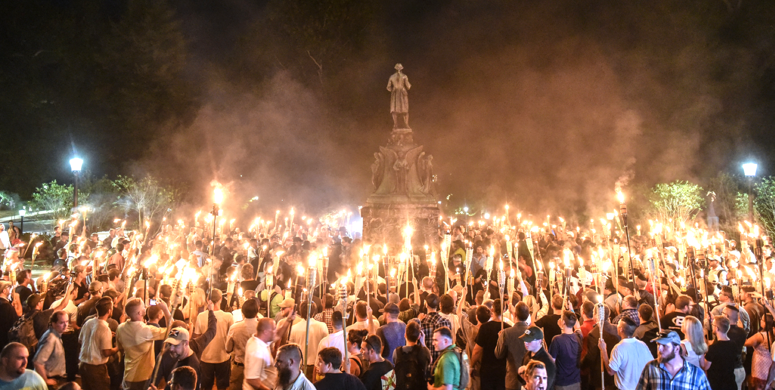
Instruction Discussion Points: Political Climate
Notes:
During my presentation some of my discussion points included the political climate, in particular the 2016 election and the increase of antisemitism during and after it. I also made a point to acknowledge that antisemitism exists on the left. By acknowledging this I believe conservative students felt more comfortable speaking up—at least I saw this with one student who indicated that she was conservative but also very trouble by Trump and the antisematism he was fueling.
Image: White nationalists at the University of Virginia the night before the Unite the Right Rally in Charlottesville, Virginia. Taken on August 11, 2017 by Stephen Keith for Reuters.

Slide 9
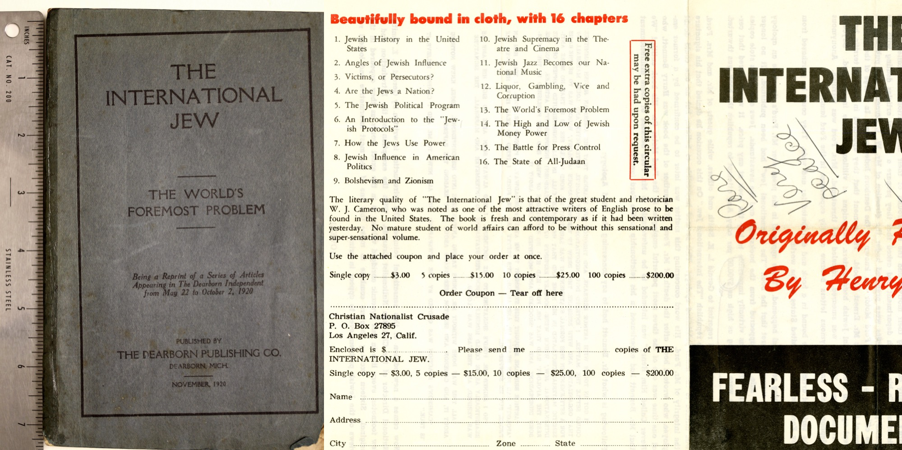
Instruction Discussion Points: Historical Example
Notes:
I used Henry Ford’s “The International Jew” to talked about how antisemitism was spread through earlier forms media. Originally this text was published as a series of booklets and pamphlets and eventually bound in a single text. What I wanted students to think about was not just the content of the text, but also the text’s portability and affordability. It was created to be easily and quickly disseminated.
Image: The International Jew house at Loyola Marymount University’s William H. Hannon Library, Department of Archives and Special Collections.

Slide 10




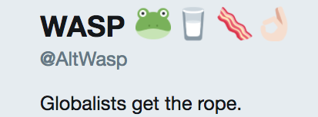
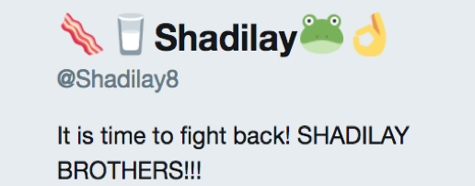
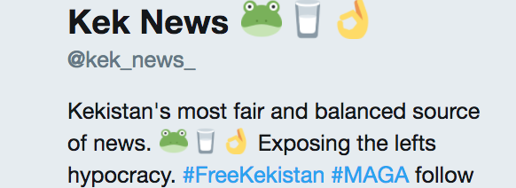
Instruction Discussion Points: Decoding Emojis
Notes:
Emojis was another point of discussion. I wanted students to understand how they can be used as a kind of code, but also to be careful about reading too much into them. In other words, don’t just take them at face value, look deeper.

Slide 11

“When I searched ‘George Soros’ in Google all of this bad stuff came up and so I thought he was a bad guy. But then I did more research and realized that a lot of the information I found about him was wrong. This made me see that Google results can contain a lot of false and antisemetic information.”
Assignment Impact
Notes:
It was clear how much of an impact the assignment had when I watched the students’ presentations. They were thorough, thoughtful, well researched and their analysis was well articulated.
One student in particular impressed me when she said: “When I searched ‘George Soros’ in Google all of this bad stuff came up and so I thought he was a bad guy. But then I did more research and realized that a lot of the information I found about him was wrong. This made me see that Google results can contain a lot of false and antisemetic information.”
We had not discussed Google and antisemitism. This very bright student came to this conclusion on her own.

Slide 12
Antisemitism on Twitter
Teaching Students How to Analyze Online Hate Through
A Simple Information Literacy Assignment
https://bit.ly/2xouTG0
Melanie Hubbard, DS Librarian
Loyola Marymount University
Notes:
Dr. Feinstein described the students’ presentations and essays as stellar and said that the assignment enabled them to take what they had learned and apply it to contemporary examples of antisemitism.
I believe the greatest contributor to the success of the assignment was that the content the students were learning in class led right to it. They were studying antisemitism through time, and this assignment connected what they had learned about the past with the present. Additionally, prior to being given the assignment, Dr. Feinstein had the students write reports (mini-research papers) about the development of antisemitic imagery and stereotypes over the centuries and across geographic regions, which gave them a visual vocabulary.

