Slide 1
Evaluating Information
Question Everything

Slide 2

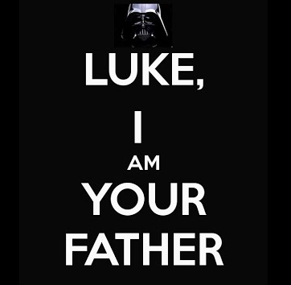
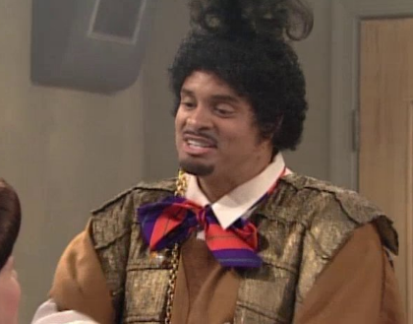


Mandela Effect

Slide 3
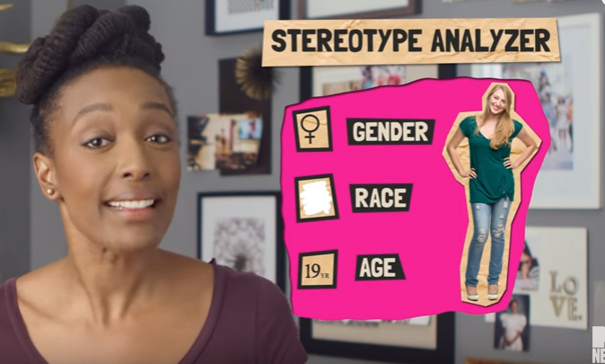
Stereotypes
“cognitive shortcuts” that lead to bias

Slide 4
Confirmation Bias
Once we have formed a view, we embrace information that confirms that view while ignoring, or rejecting, information that casts doubt on it.
Confirmation bias suggests that we don’t perceive circumstances objectively. We pick out those bits of data that make us feel good because they confirm our prejudices.
- https://www.psychologytoday.com/blog/science-choice/201504/what-is-confirmation-bias

Slide 5
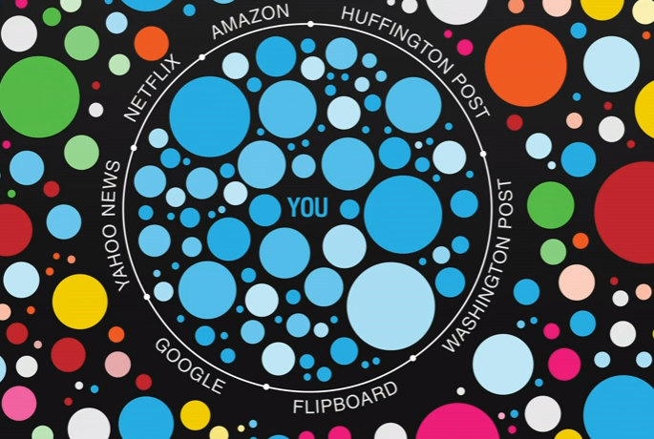
Filter Bubble
“The internet is showing us what it thinks we want to see, not necessarily what we need to see” – Eli Pariser, TED Talk 2011
http://graphics.wsj.com.via.snip.ly/ni3b3#http://graphics.wsj.com/blue-feed-red-feed/

Slide 6
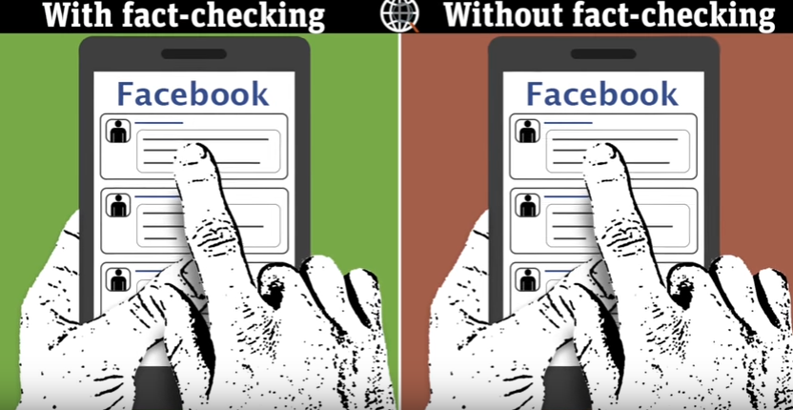
What happens when we fail to check our bias?

Slide 7
What is “fake news?”
Who is creating it?
Where is it coming from?
Why are people creating it?
http://abcnews.go.com/Technology/fake-news-stories-make-real-news-headlines/story?id=43845383
https://www.nytimes.com/2016/11/20/business/media/how-fake-news-spreads.html?_r=0

Slide 8
Examine:
1. URL: http://abcnews.com.co/ vs. http://abcnews.go.com/
2. Grammar, spelling, graphics & overall design
3. Author & Publisher
4. Your own response

Slide 9
Verify
1. Is anyone else writing about this story? If so, who?
2. What evidence does the site provide to prove their claim – is this valid evidence?
3. Read the “about us”
4. Check snopes.com or other fact- checking sites

Slide 10
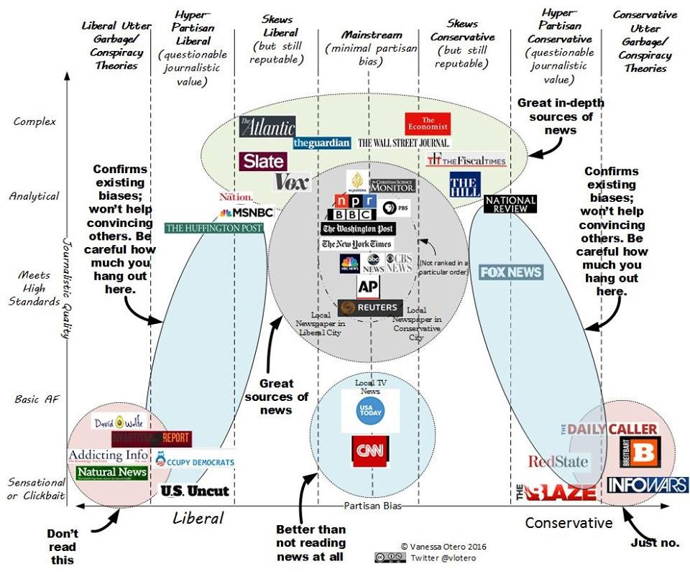
Understand Bias

Slide 11

CRAAP TEST
Currency:
WHEN WAS IT WRITTEN?
Relevance:
HOW DO YOU WANT TO USE IT?
Accuracy:
WHAT DOES IT SAY?
Authority:
WHO IS RESPONSIBLE FOR IT?
Purpose:
WHY WAS IT WRITTEN?

Slide 12
EPIC
Education:
Does the author “know of”?
Proximity:
How close is author to the story?
Integrity:
Can we trust this person?
Competence:
Does the author “know how”?

Slide 13
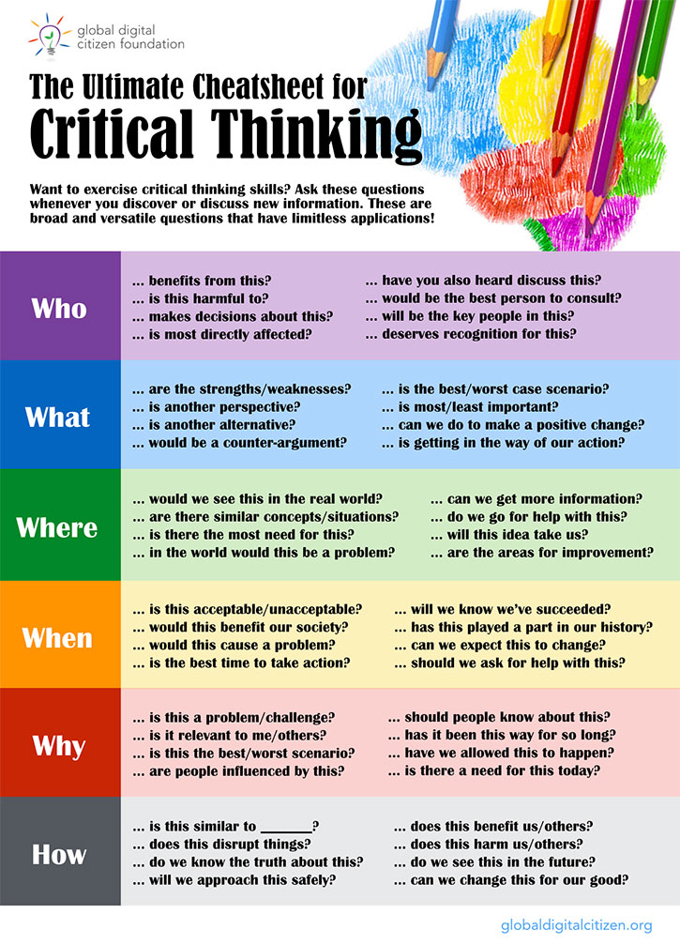
Think Critically

Slide 14

Created By:
Jen Hasse
Information Literacy Librarian
Holy Spirit Library
Cabrini University

