Slide 1
Activity 1: Critically Reading Scope Notes/Database Descriptions Student Learning Objective: The student will apply practical critical reading skills in order to determine database (information resource) relevancy to an information need.
ACRL Framework 3: Information Has Value
3.5 Recognize issues of access or lack of access to information sources. (proprietary vs. free, tuition paying student access vs. non-student, institutional subscription vs. private).
ACRL Framework 6: Searching as Strategic Exploration
6.3 Utilize divergent and convergent thinking when searching.
6.4 Match information need to search tool/resource.
APA Guidelines
2.2c Identify and navigate psychology databases and other legitimate sources of psychology information.
2.2d Articulate criteria for identifying objective sources of psychology information.
Critical reading pedagogy: narrative text, unfamiliar vocabulary from both library-science and psychology disciplines.

Slide 2
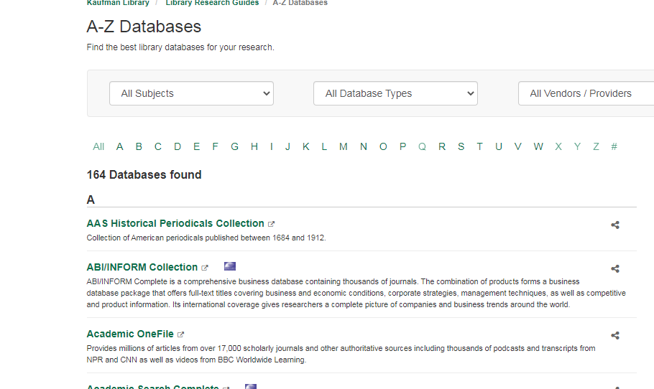
Tools for Instruction
Database List
Scope Notes
(Database Descriptions)
Background Vocabulary:
Database
Proprietary
Subscription costs
Institutional
Individual
Notes:
Criti

Slide 3
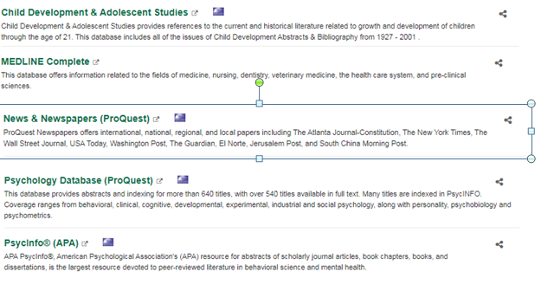
Tools for Instruction
Vocabulary:
Issues
Abstracts
Indexing
Scholarly journal articles
Peer-reviewed
APA

Slide 4
Learning Activity Visual
Sample/ Interrogation

Slide 5
Learning Activity
Part I
Questions About the Scope Notes
(Hint: Not all questions have answers).
What is the name of the database?
What publication years are included in the database?
Who created the database?
Who is it for? Who are the users?
What titles are included in the database?
How many titles are included in the database?
Does it boast as being the largest? The best?
Why might you use the database?
Sample/ Interrogation

Slide 6
Learning Activity
Part 2
Sample/ Interrogation
Activity: Utilizing a database list and scope notes, select the best resource choice based on an
information need.
Scenarios:
1)Find everything you can about clinical depression in peer-reviewed
psychology and psychiatry (medical) sources. Based on the information before you, what are the best
choices?
2) Information need: You must find articles in the child development literature about motherhood in
the early 1900's - 1960's. Based on the information before you, what is the best choice? Is their a second choice? Be ready to
explain your selection.
3) Information need: You must find information about recent (in the last two weeks) about either
homelessness or mental illness in your city or state. Based on the information before you, what is the best choice? There is only one. Be ready to explain your selection.
4) Information need: You must find articles in the psychology literature about college students and
dating choices. Based on the information before you, what are the best choices? There are two. Be ready
to explain your selections.
Additional optional activity: Allow students time to search the above topics (basic keywords- nothing fancy)
in the correct database(s). Next, have students select a different database. Students share what they missed or gained by changing databases.
Alternate activity: students may use a topic related to a real assignment.

