Slide 1
Activity 2: Critically Reading the Brief Citation Student Learning Objective: : The student will apply practical critical reading skills in order to determine citation relevancy for a given information need.
ACRL Framework 4 Research as Inquiry
4.5 Monitor gathered information and assess for gaps or weaknesses.
ACRL Framework 6 Searching as strategic exploration.
6.6 Understand how information systems are organized to access relevant information.
APA Guidelines
2.2c Identify and navigate psychology databases and other legitimate sources of psychology information.
2.2d Articulate criteria for identifying objective sources of psychology information
Critical reading pedagogy: paradigmatic text, unfamiliar vocabulary, fluency stoppers (spaces, colons, numbers), sample citation/interrogation method.

Slide 2
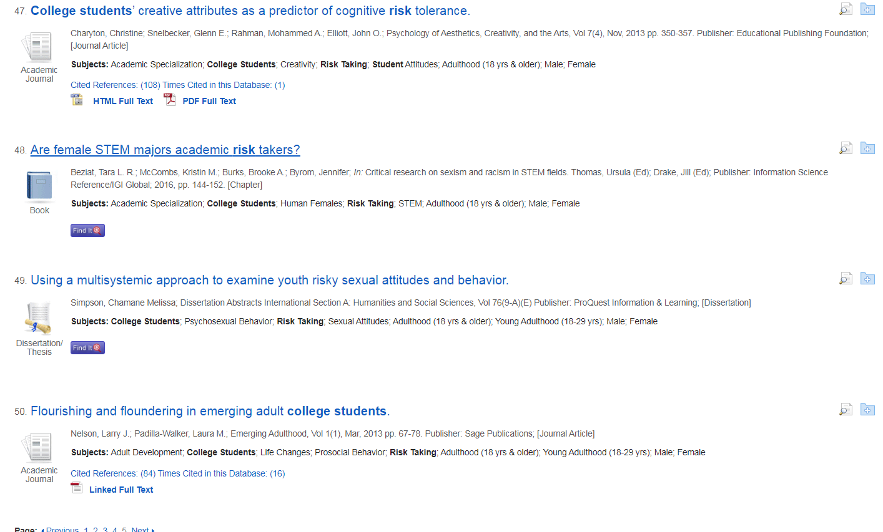
Tools for Instruction
Citation List
Vocabulary:
Brief Citation
Title
Vol.
Year
Pages
Subjects
Journal
Book
Thesis/Dissertation
Demonstrate: suppressing unnecessary information, reading/think aloud, identify two-three concepts
for determining relevancy.

Slide 3
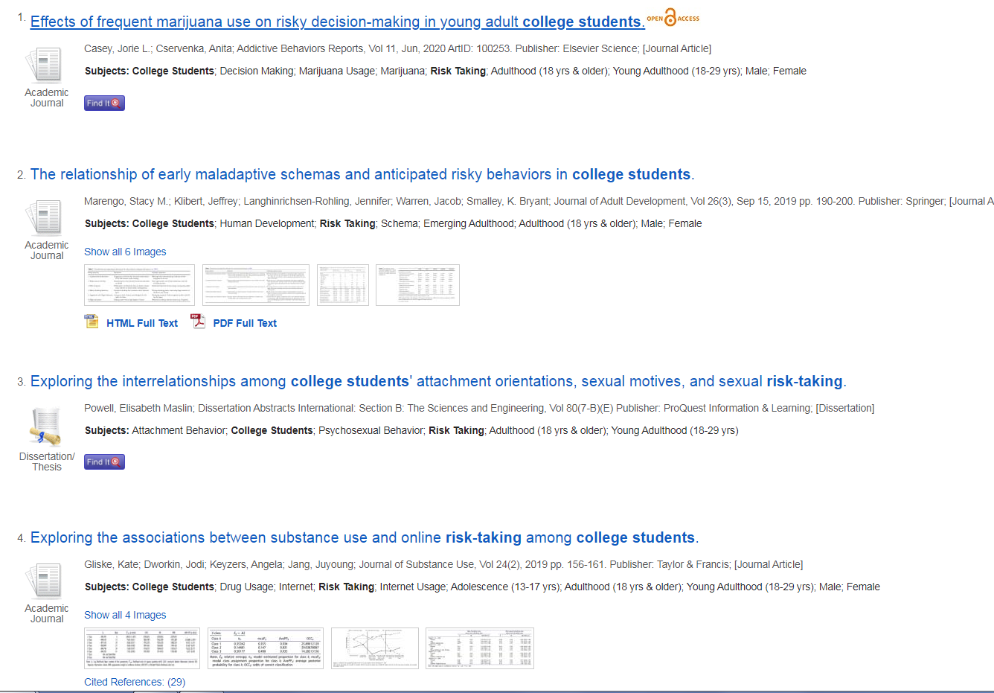
Learning Activity Visual
Sample/ Interrogation

Slide 4
Learning Activity
Sample/ Interrogation
Activity:
Utilizing the list of brief citations, identify two relevant and cohesive journal articles.
Information need: A brief research paper about [risk taking and college students].Your information must be from a
scholarly journal, it must have been published in the last 8 years, it must be a research study. Looking at the list before you, answer the following questions:
What is the title?
How long is the article? List number of pages/Requires further examination.
Is it from a scholarly/academic journal?
Are you sure it is a research study? Yes/No, Requires further examination.
Is the article full-text? Yes/No, Requires further examination.

