Slide 1
Activity 6: Critically Reading the Thesaurus and Performing a Search Student Learning Objective: The student will apply practical critical reading skills to identify discipline specific terminology in order to find pertinent information sources.
ACRL Framework 6. Searching as Strategic Exploration
6.5 Design and refine needs and search strategies, based on search results.
6.7 Use different search language types: controlled vocabulary, natural language.
APA Guidelines
2.2c Identify and navigate psychology databases and other legitimate sources of psychology information.
Critical reading pedagogy: paradigmatic, lists, numbers.

Slide 2
Tools for Instruction
Discuss main idea of the article.
(Test Tube Baby)

Slide 3
Tools for Instruction
Demonstrate locating more articles about the topic by doing a keyword search with the main idea of the article. (Test Tube Baby)
Test tube baby = 8 sources
Test tube babies = 15
Reproductive technology = more than 1400 sources
Demonstrate locating more articles about the topic by using the thesaurus.

Slide 4
Tools for Instruction
Demonstrate locating more articles about the topic by reading the subjects and identifying the most relevant terms.
Search Reproductive technology = more than 1400 sources.

Slide 5
Sample/Interrogation
Learning Activity
Activity: Provide students with brief citations with obvious key word terms.
(But not so obvious subject headings/controlled vocabulary).
Ask students to find more articles about the topic using natural language and
controlled vocabulary.
Questions:
What is a natural language term(s) you might use as a search?
What is the thesaurus term(s) (controlled vocabulary) for the topic?
How many results using keyword/natural language terms?
How many results using controlled vocabulary/thesaurus terms?
Select an article that seems relevant to the topic.
What are are the main subjects of the article?
Is the article about your topic?
Is the document type a journal article?

Slide 6
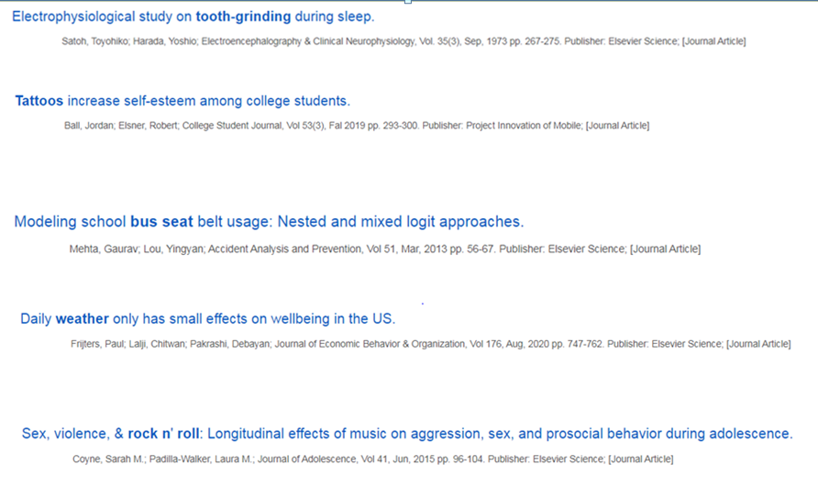
Sample/Interrogation
Learning Activity Visual

