Slide 1
1
ZINES 101
Aisha Conner-Gaten, she/her
What are Zines?
Zine History
Why Zines?
Zine Review
Research

Slide 2
2
What are Zines?
short for fan magazine and fanzine
Generally photocopied paper or card stock
Small, self-distributed print run
portable
Personal reflections (per-zines), collective commentary, etc.
Types include comix, compilation (compzines), DIY, fanzine, political, art, split, etc.
Subcomandante Insurgente Marcos. Chiapas: The Southeast in Two Winds. Internet Archive, http://archive.org/details/ChiapasTheSoutheastInTwoWinds. Accessed 5 Nov. 2019.
Angela Davis. Lectures on Liberation. Internet Archive, http://archive.org/details/LecturesOnLiberation. Accessed 5 Nov. 2019.
Notes:
Some folks say noncommercial or non professional but we have industries of zines now
Considered primary sources as they can be reflections of current issues and contexts

Slide 3
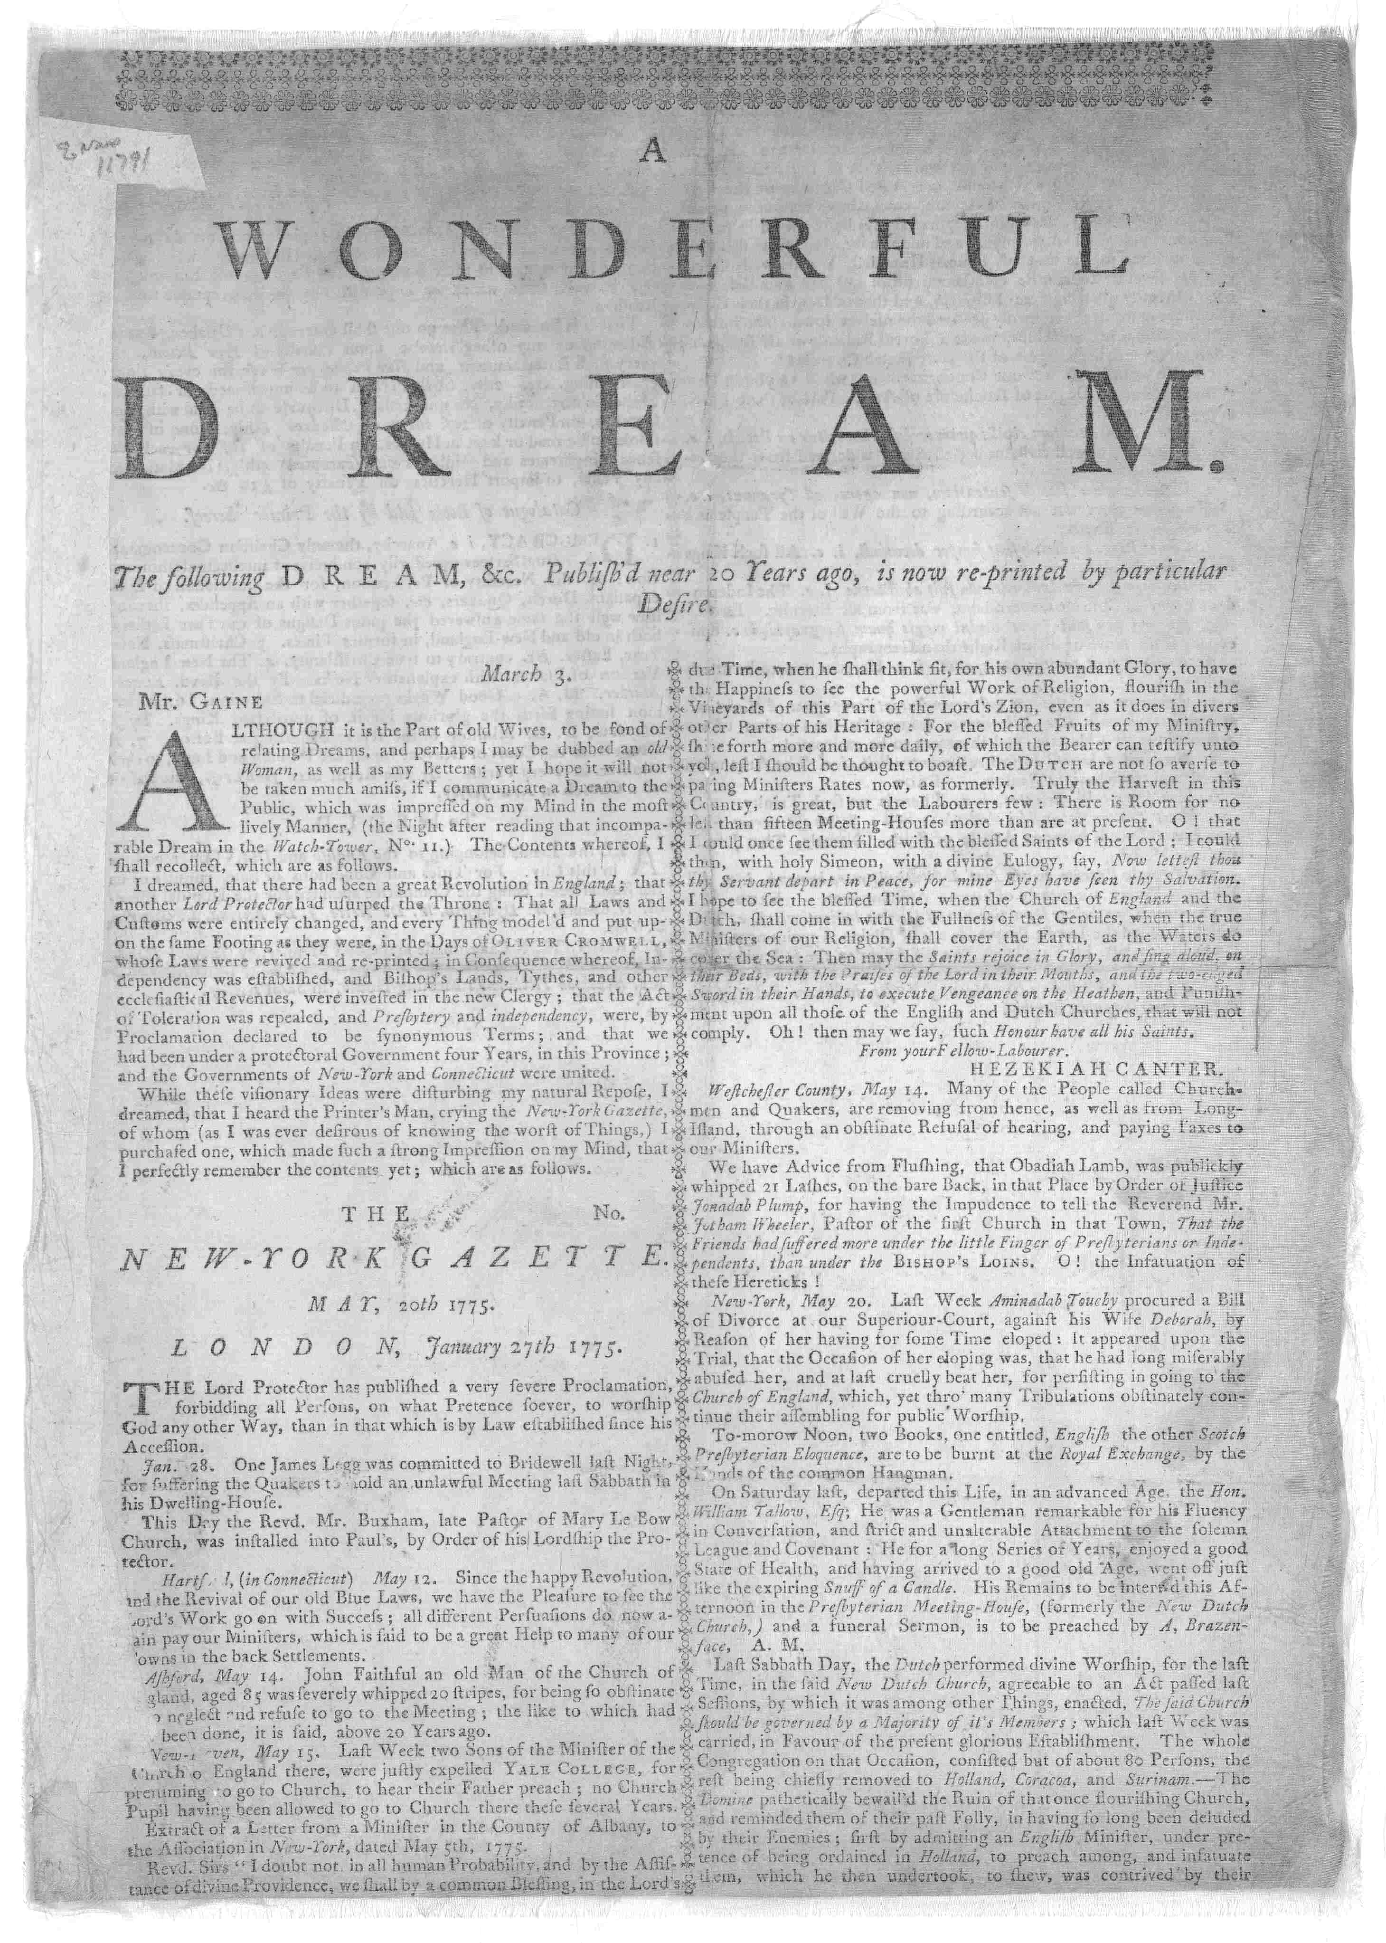
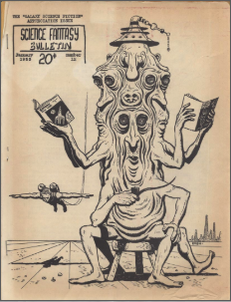
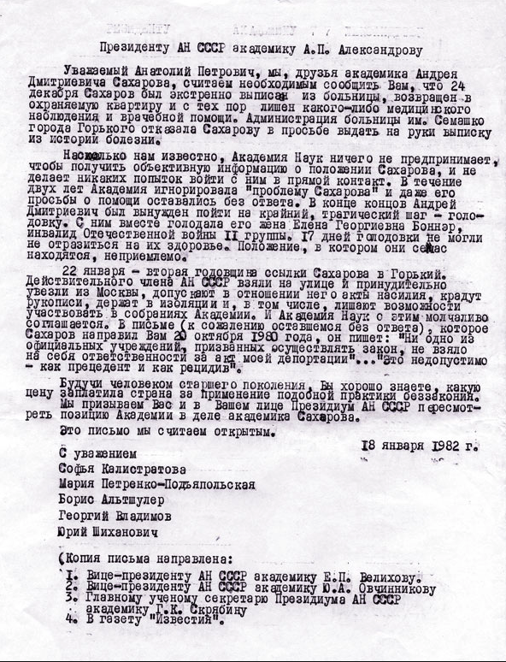
3
A (very short) Zine History
Broadsides, pamphlets, factsheets
Samzidat from the Soviet Union
Science Fiction fanzine
1770s
1920s
1930s
1940s
1950s
Dada with surrealists, expressionists, and cubists
Beat poetry chapbooks
“A Wonderful Dream. The Following Dream, &c. Publish’d near 20 Years Ago, Is Now Re-Printed by Particular Desire. [New York: Printed by John Holt, 1770].” Library of Congress, Washington, D.C. 20540 USA, https://www.loc.gov/item/rbpe.1040040a/. Accessed 5 Nov. 2019.
Gulag: Soviet Forced Labor Camps and the Struggle for Freedom. http://gulaghistory.org/nps/onlineexhibit/dissidents/movement.php. Accessed 5 Nov. 2019.
Science Fiction Pulps & Fanzines. https://library.umbc.edu/speccoll/scifi/. Accessed 5 Nov. 2019.
Notes:
1517?: Luther’s 95 Theses as the first major zine (specific, self-made and published)
1770s: American Revolution broadsides
1920s: surrealist, dada (artists and the avant garde critique of the bourgeois)
1930s: sci fi (met at conventions and readings, also Amazing Stories and Weird Tales or professional zines from major newsstands)
1940s: beat poetry chapbooks aka Allen Ginsburg and San Fran friends
1950s: samizdat (Soviet Union DIY, literature secretly written, copied, and circulated in the former Soviet Union and usually critical of practices of the Soviet government)
1960s: comics
1970s: punk
1990s: riot grrl

Slide 4
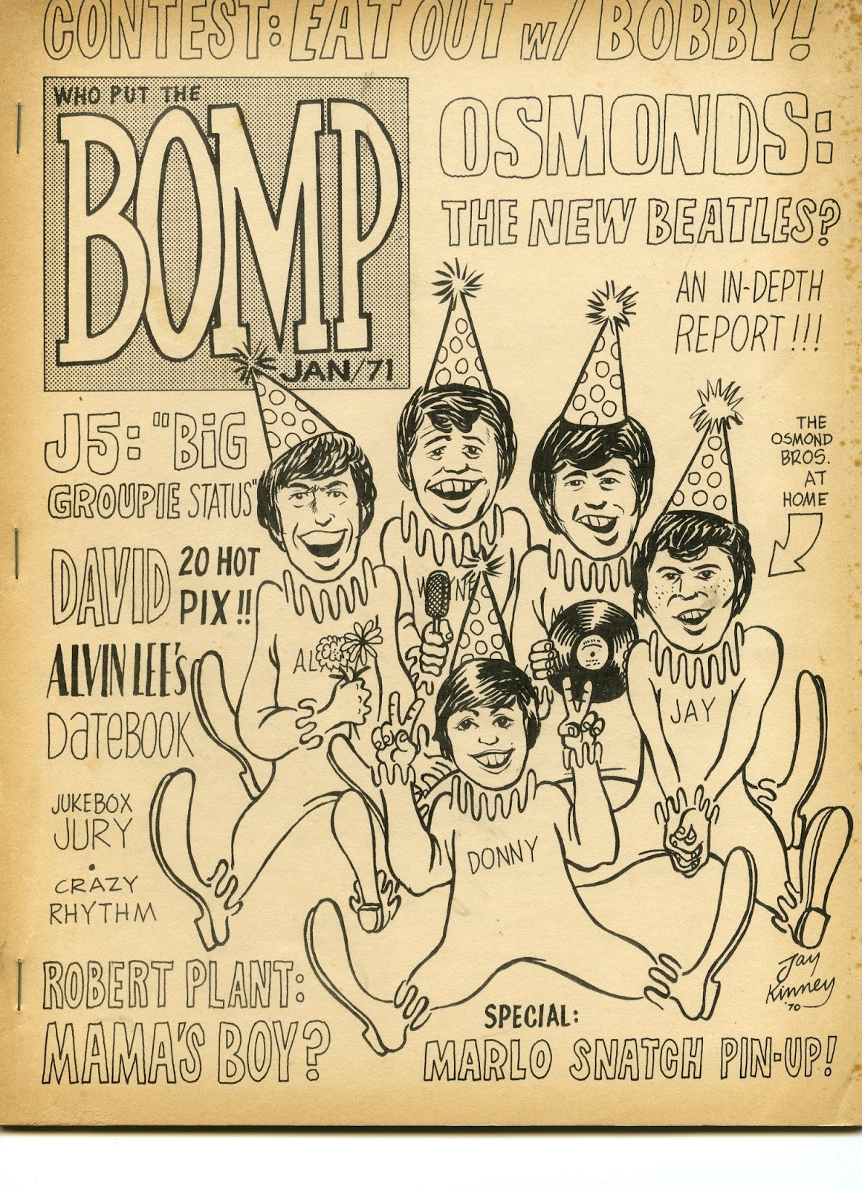
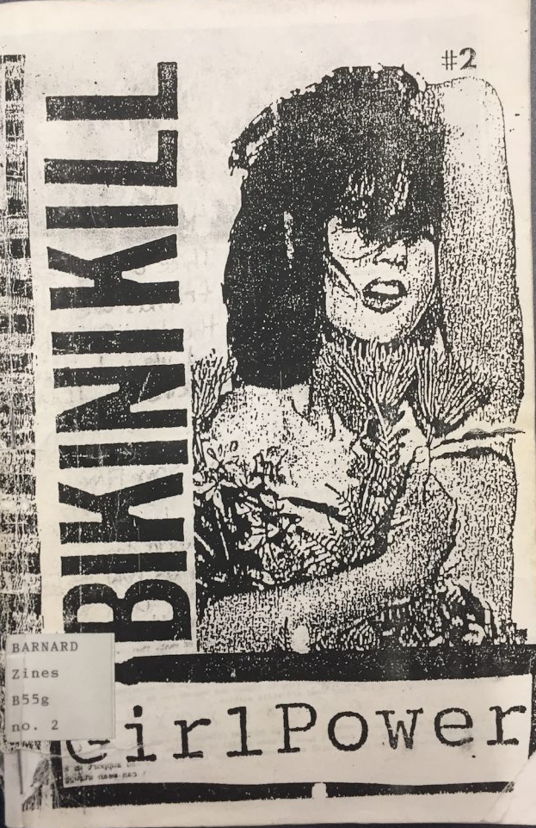
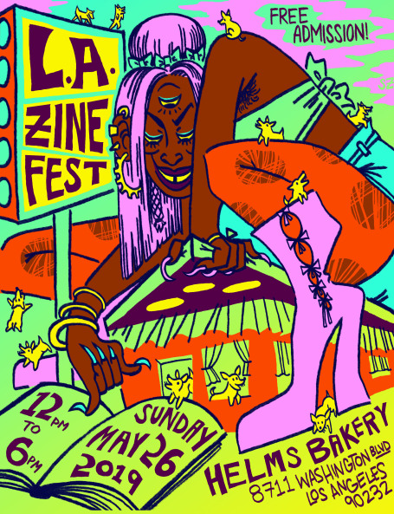
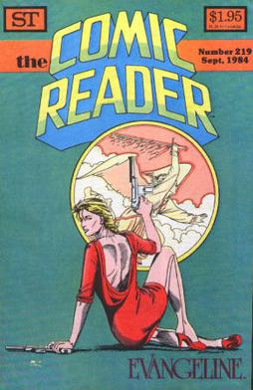
4
A (very short) Zine History
Bomp.Jpg (1160×1600). http://2.bp.blogspot.com/-xv6fbCB4iyQ/UhEnhfhGWkI/AAAAAAAAMRY/ENhgYYo1CWU/s1600/bomp.jpg. Accessed 5 Nov. 2019.
“The Comic Reader.” Wikipedia, 20 June 2018. Wikipedia, https://en.wikipedia.org/w/index.php?title=The_Comic_Reader&oldid=846669901.
“Bikini Kill.” Artzines, 19 June 2017, http://www.artzines.info/bikini-kill/.
“L.A. Zine Fest.” L.A. Zine Fest, https://lazinefest.com/. Accessed 5 Nov. 2019.
1960s
1970s
1990s
NOW
comics
punk scene
Riot Grrl & International Pop Underground Convention in Washington, D.C. (1991)
Zine fests, conventions, libraries, & small presses
Notes:
1517?: Luther’s 95 Theses as the first major zine (specific, self-made and published)
1770s: American Revolution broadsides
1920s: surrealist, dada (artists and the avant garde critique of the bourgeois)
1930s: sci fi (met at conventions and readings, also Amazing Stories and Weird Tales or professional zines from major newsstands)
1940s: beat poetry chapbooks aka Allen Ginsburg and San Fran friends
1950s: samizdat (Soviet Union DIY, literature secretly written, copied, and circulated in the former Soviet Union and usually critical of practices of the Soviet government)
1960s: comics (industry news and information magazine (The Comic Reader was one example), interview, history and review-based fanzines)
1970s: punk (established punk culture, bands included like the Ramones, direction action and non-conformity)
1990s: riot grrl (Riot Grrrl began in 1991, when a group of women from Washington, D.C., and Olympia, Washington, held a meeting to discuss how to address sexism in the punk scene. punks liked "producing a paper unhampered by corporate structure, cash and censorship”, first major event in 91: International Pop Underground Convention in Washington, D.C.)

Slide 5
5
Your turn:
Fill out
The
DREAMS OF ZINES
page in your
Mini-zine

Slide 6
Why Zines?
6
Urge us to think about authority in differing contexts
Provide space for marginalized voices
Reframe topics we talk about in class and life
Channel our thoughts creatively into art

Slide 7
Zine Checklist
7
Paper
Printer paper, card stock, spiral-bound sheets
Writing Utensils
4B Pencils (rather than no. 2), non-photo blue pencil, markers, small brush and ink
Note: ball point pens can copy streaky
Stapler or folds
How will you combine your sheets? Are you just folding the paper in half? Thirds?
Materials
Varies wildly. Repurpose any materials of interest to you like newspapers, fabric, images, drawn art
Photocopier
Zines are for sharing. Remember that this will be replicated. What will show best as a copied text?
Notes:
Elements of design to consider including how lines can tell your reader where to look, spacing, color, texture, and value. Photocopying means you can play with shades of greyscale

Slide 8
8
What zine types are there?
Todd, Mark. What’s a Zine?: The Art of Making Zines and Mini-Comics. Pp.45. HOUGHTON MIFFLIN, 2006.

Slide 9
Your turn: blind date with a Zine
9
Use your mini-zine and answer questions on (pages 3-5):
Medium
Purpose
Authorship
Pair and share when you’re finished

Slide 10
Using the Databases
10
01
Start with Women’s and Gender libguide: http://libguides.lmu.edu/womengender
STEP
02
Establish a thesaurus of keywords
STEP
03
Use “and”, *, “or” to build your search strategies
STEP
Notes:
We have ArtStor for images, Oxford Art Online,
drama online for plays,
literature online for poetry, drama and prose.
African Writers Series for fiction, poetry, drama and prose

Slide 11
11
There’s
no
Wrong way
To make
A zine.

Slide 12
Thank Yous to Strangers
“A Wonderful Dream. The Following Dream, &c. Publish’d near 20 Years Ago, Is Now Re-Printed by Particular Desire. [New York: Printed by John Holt, 1770].” Library of Congress, Washington, D.C. 20540 USA, https://www.loc.gov/item/rbpe.1040040a/. Accessed 5 Nov. 2019.
Angela Davis. Lectures on Liberation. Internet Archive, http://archive.org/details/LecturesOnLiberation. Accessed 5 Nov. 2019.
Are Zines Blogs? | Barnard Zine Library. https://zines.barnard.edu/are-zines-blogs. Accessed 5 Nov. 2019.
Betty Bowers. Coexist. Internet Archive, http://archive.org/details/Coexist_499. Accessed 5 Nov. 2019.
“Bikini Kill.” Artzines, 19 June 2017, http://www.artzines.info/bikini-kill/.
Bomp.Jpg (1160×1600). http://2.bp.blogspot.com/-xv6fbCB4iyQ/UhEnhfhGWkI/AAAAAAAAMRY/ENhgYYo1CWU/s1600/bomp.jpg. Accessed 5 Nov. 2019.
Gulag: Soviet Forced Labor Camps and the Struggle for Freedom. http://gulaghistory.org/nps/onlineexhibit/dissidents/movement.php. Accessed 5 Nov. 2019.
“L.A. Zine Fest.” L.A. Zine Fest, https://lazinefest.com/. Accessed 5 Nov. 2019.
“Punk Zine.” Wikipedia, 24 Sept. 2019. Wikipedia, https://en.wikipedia.org/w/index.php?title=Punk_zine&oldid=917618884.
Riot Grrrl – Subcultures and Sociology. https://haenfler.sites.grinnell.edu/subcultures-and-scenes/riot-grrrl-2/. Accessed 5 Nov. 2019.
“Samizdat | Soviet Literature.” Encyclopedia Britannica, https://www.britannica.com/technology/samizdat. Accessed 5 Nov. 2019.
Samizdat | Soviet Literature | Britannica.Com. https://www.britannica.com/technology/samizdat. Accessed 5 Nov. 2019.
Science Fiction Pulps & Fanzines. https://library.umbc.edu/speccoll/scifi/. Accessed 5 Nov. 2019.
Slania, Heather. LibGuides: Zine Collection: Teaching with Zines. //libguides.mica.edu/zines/teaching. Accessed 5 Nov. 2019.
Subcomandante Insurgente Marcos. Chiapas: The Southeast in Two Winds. Internet Archive, http://archive.org/details/ChiapasTheSoutheastInTwoWinds. Accessed 5 Nov. 2019.
“The Comic Reader.” Wikipedia, 20 June 2018. Wikipedia, https://en.wikipedia.org/w/index.php?title=The_Comic_Reader&oldid=846669901.
The History of Riot Grrls - The Feminist EZine. http://www.feministezine.com/feminist/music/The-History-of-Riot-Grrls-in-Music.html. Accessed 5 Nov. 2019.
Todd, Mark. What’s a Zine?: The Art of Making Zines and Mini-Comics. HOUGHTON MIFFLIN, 2006.
Welcome! - Riot Grrrl Research - LibGuides at Loyola Marymount University. https://libguides.lmu.edu/riotgrrrl. Accessed 5 Nov. 2019.
“Zine.” Wikipedia, 30 Oct. 2019. Wikipedia, https://en.wikipedia.org/w/index.php?title=Zine&oldid=923771152.
Zine Presentation. YouTube, https://www.youtube.com/watch?v=ZcV3rjEg0hU&t=. Accessed 5 Nov. 2019.
Zines, E-Zines: Approaching the ’80s Zine Scene. http://www.zinebook.com/resource/perkins.html. Accessed 5 Nov. 2019.
Zinesinclassroom.Pdf. https://zines.barnard.edu/sites/default/files/inline-files/zinesinclassroom.pdf. Accessed 5 Nov. 2019.

