Slide 1
Critical Appraisal of the Medical Literature
Michelle Keba Knecht, MSIS, MSL
Senior Medical Librarian
Presentation for FOM 2
2/9/2023

Slide 2
Agenda
Review EBM and GRADED Assignment for CLG
Intro to Critical Appraisal

Slide 3
Evidence-Based Medicine
Best Research Evidence
Patient Values
Clinical Expertise
EBM
Notes:
EBM is the purposeful use of current best evidence to make clinical decisions about the care of an individual patient.
EBM integrates the best available clinical evidence with clinical expertise and patient values

Slide 4
5 Steps in EBM
Assess
Focused, answerable clinical question
The best available evidence to answer clinical question
The evidence for its validity and applicability to the patient’s care
By integrating the appraised evidence with clinical expertise and patient’s unique circumstances
Your effectiveness and efficiency in carrying out all steps; AND follow up with patient!
Apply
Appraise
Acquire
Ask

Slide 5
Assignment Objective
To assess student’s ability to appraise and assimilate scientific evidence.
Notes:
Reflect on and evaluate one’s own performance
Continuously improve performance based on constant self-evaluation and life-long learning

Slide 6
Assignment Instructions
Read the randomized controlled trial article that will be provided with your Standardized Patient session.
Each student will use the CASP RCT Checklist to answer the 12 questions posed (See OwlMed for Assignment details & CASP checklist).
Type your name on the CASP document!
Answer all questions and be sure to type a narrative explanation for all answers.
Submit completed CASP Checklist to OwlMed. (Check OwlMed for the assignment due date).

Slide 7
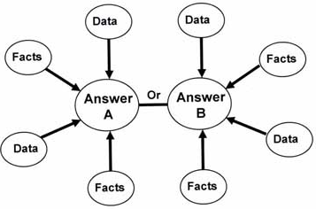
Assignment Grading
The assignment will be graded as Satisfactory (S), Satisfactory with Concern (SWC), or Unsatisfactory (U).
Before you submit, please make sure you:
Successfully followed all assignment instructions.
Submitted the completed CASP tool to OwlMed on time.
Provided appropriate responses to all answers of the CASP tool.
Included a typed narrative in addition to typing “Yes” “No” or “Can’t tell” [as appropriate] for each question.
Grading will be based on the clarity and quality of your rationale for each response with well-supported statements using evidence (data/information/facts) from the study.
Notes:
Receiving a grade of U on this assignment means that you fail the competency and the course!

Slide 8
CRITICAL APPRAISAL SKILLS PROGRAMME (CASP) Checklists
Systematic reviews
Randomized controlled trials
Cohort studies
Case control studies
Diagnostic test studies
Economic evaluation studies
Qualitative research studies
http://www.casp-uk.net/casp-tools-checklists/
©Critical Appraisal Skills Programme (CASP)

Slide 9
Why is Critical Appraisal Important?

Slide 10
“Less than 1% of people become addicted to Oxycotin”

Slide 11
New England Journal of Medicine

Slide 12
Critical Appraisal
Evaluating sources vs. Critical appraisal of clinical research
“Critical appraisal is the process of carefully and systematically examining research to judge its trustworthiness, and its value and relevance in a particular context.”
“It is an essential skill for evidence-based practice because it allows… clinicians to find and use research evidence reliably and efficiently to inform their decision-making.”
Notes:
So, how can you tell whether a piece of research has been done properly and that the information it reports is reliable and trustworthy?
How can you decide what to believe when research on the same topic comes to contradictory conclusions?
This is where critical appraisal skills help.

Slide 13
Critical Appraisal in 3 Steps:
Are the results of the trial valid? (How serious is the risk of bias?)
What are the results?
Can the results be applied to your patient?
In this presentation, we will be critically appraising the following article together:
Hemamy M, Pahlavani N, Amanollahi A, et al. The effect of vitamin D and magnesium supplementation on the mental health status of attention-deficit hyperactive children: a randomized controlled trial [published correction appears in BMC Pediatr. 2021 May 12;21(1):230]. BMC Pediatr. 2021;21(1):178. Published 2021 Apr 17. doi:10.1186/s12887-021-02631-1

Slide 14
Are the results of the trial valid?

Slide 15
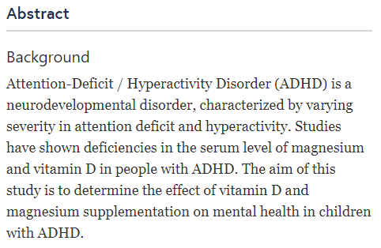
1. Did the study address a clearly focused research question?
The study should have a clear research objective.
The authors should identify the population studied and the outcomes considered.
Depending on the type of study, the authors should identify the intervention given and the comparison given.

Slide 16
2. Was the assignment of patients to interventions randomized?
Randomization is a technique for assigning patients to either the treatment or control group entirely by chance and without the influence of the researcher.
Randomization balances both known & unknown prognostic factors between the groups.
Allocation concealment refers to protecting the randomization list.
An independent center used computer generated randomization tables to create opaque, sealed envelopes with treatment assignments
A remote call center enrolling patients using a random number generator to assign patients to the treatment arms
Notes:
What could happen if the researchers or the patients were able to choose which group they were in?
(There could be an issue of selection bias.)
Selection bias: Systematic differences between baseline characteristics of the groups that are compared (biased allocation to interventions).

Slide 17
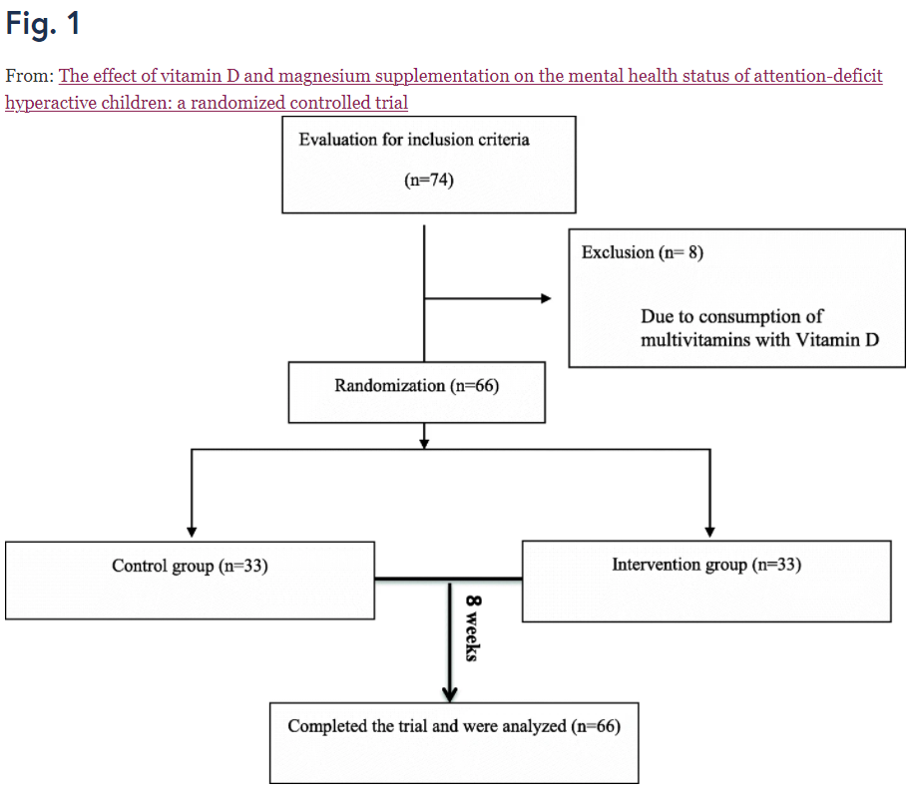
3. Were all participants who entered the study accounted for at its conclusion?
Duration of follow-up needs to be long enough for outcome to develop or for adverse events to take place.
Guidelines for good studies is < 10% loss to follow-up.
Once patients are randomized into study arms they must be analyzed in that group, even if they refuse treatment or are allowed to change groups. This is called intention-to-treat analysis.
Notes:
How many of these patients were lost to follow up?
(none)
What would happen if too many patients were lost to follow up?
(There could be an issue of attrition bias.)
Attrition bias: Systematic differences between groups in withdraws from the study
ITT- protects randomization, keeps prognostic factors balanced, mimics real life (condom example)

Slide 18
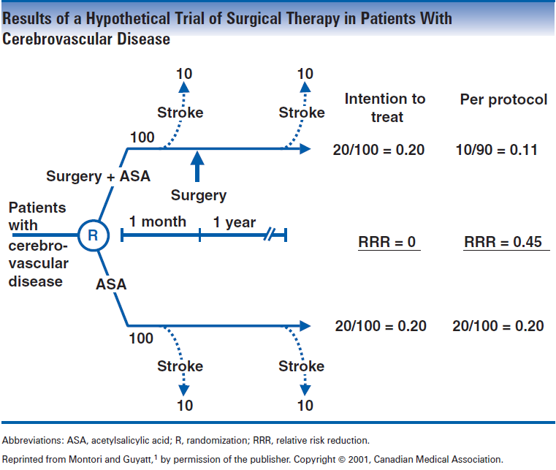
Guyatt et al, Users' Guides to the Medical Literature: A manual for evidence-based clinical practice, 2nd Edition, Chapter on Therapy, JAMA Evidence, 2008
Notes:
Researchers want to study the effect of an experimental surgical procedure to prevent stroke in patients with cerebrovascular disease. They enroll 200 patients in an RCT. There are 100 patients in the intervention arm (surgery + aspirin therapy) and 100 patients in the control arm (aspirin therapy alone). The primary outcome is stroke. There is a one-month preoperative waiting period and in that one month, 10 patients randomized to the intervention arm had a stroke and their surgery was canceled. In the remaining 90 in the intervention arm, 10 had a stroke. In the control group, 20 people had a stroke. Now compare the relative risk reduction using ITT and per-protocol.

Slide 19
4. Were participants, investigators and people assessing/analyzing outcomes ‘blind’ to the intervention?
Blinding is also known as “masking” and means that the people involved in the study are unaware of treatment group assignment.
Occurs AFTER randomization
Single- vs. Double- vs. Triple-Blind?
Who needs to be blinded?
Participants
Clinicians
Data Collectors
Data Analyzers
Adjudicators of Outcome
Notes:
What could happen if the people involved in the study are not blinded?
(There could be an issue of performance bias and/or detection bias.)
Performance bias: Systematic differences between groups in the care that is provided, or in exposure to factors other than the interventions of interest.
Detection bias: Systematic differences between groups in how outcomes are determined.

Slide 20
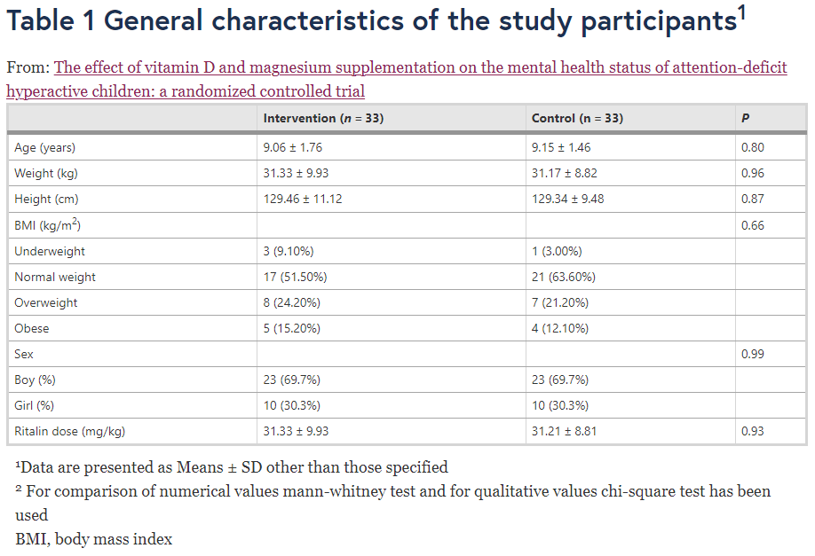
5. Were the study groups similar at the start of the randomized control trial?
Prognostic factors (such as age, gender, weight, lab results etc.) should be similar for both the treatment and control groups.
Typically each group’s baseline characteristics are summarized in Table 1. Start by looking for the table of baseline characteristics when answering this question.
Notes:
Were these groups similar at the start of the trial?
(Yes, means and P-values are provided for comparison in Table 1)
Point of reviewing table 1 is to determine if randomization was successful and for potential confounders that could skew results

Slide 21
6. Apart from the experimental intervention, did each study group receive the same level of care (that is, were they treated equally)?
A few questions to consider:
Can groups be treated equally if the study participants and personnel weren’t blinded?
Are the outcomes for both groups being measured in the same way/consistently?
Are there other ways that groups could be treated unequally?

Slide 22
Let’s Practice

Slide 23
An independent researcher made random allocation cards using computer generated sequence and used sequentially numbered, sealed, opaque envelopes to conceal the allocation. Neither the researcher nor the participants were aware of the groups. The intervention group received a pearl of vitamin D (50,000 IU/week with lunch meal) and an oral tablet of magnesium (6 mg/kg/day with lunch meal) for a duration of 8-weeks [28]. Participants in the control group received a placebo, similar in appearance, color and taste to the two supplements (edible paraffin oil as a placebo for vitamin D, microcrystalline cellulose and stearic acid as a placebo for magnesium).

Slide 24
An independent researcher made random allocation cards using computer generated sequence and used sequentially numbered, sealed, opaque envelopes to conceal the allocation. Neither the researcher nor the participants were aware of the groups. The intervention group received a pearl of vitamin D (50,000 IU/week with lunch meal) and an oral tablet of magnesium (6 mg/kg/day with lunch meal) for a duration of 8-weeks [28]. Participants in the control group received a placebo, similar in appearance, color and taste to the two supplements (edible paraffin oil as a placebo for vitamin D, microcrystalline cellulose and stearic acid as a placebo for magnesium).

Slide 25
What are the results?

Slide 26
Treatment Effects
You will learn how to calculate treatment effects when you study biostatistics in FOM 4.
For this assignment, you don’t need to calculate the effects such as relative risk reduction, absolute risk reduction, and number needed to treat yourself. We just want you to focus on what the authors reported and what is missing.

Slide 27
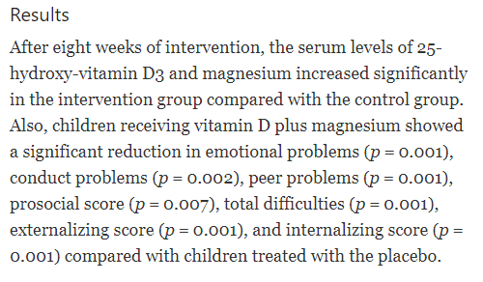
Statistical vs. Clinical Significance
How much did vitamin D plus magnesium reduce the emotional, conduct, and peer problems of children in the treatment group compared with children treated with placebo?
Notes:
The p-value DOES NOT tell us how large the differences between the two groups are.
These results are statistically significant but we don’t know if they are clinically significant. We don’t know if the difference between groups is large enough for the treatment to be worth it.
Studies can be statistically significant yet not clinically insignificant.
Stacy to mention meaningful outcomes for patients (ex of oncology studies)

Slide 28
P-Values vs. Confidence Intervals
P-Values
Confidence Intervals
The p-value only tells us if the differences between the two groups are statistically significant. If the p-value is less than 0.05 or 0.001, it’s less likely that the difference between the two groups happened by chance.
The p-value DOES NOT tell us how large the differences between the two groups are.
A confidence interval is a range that includes the true treatment effect 95% of the time. The treatment effect & confidence interval can help you determine if the results are clinically significant.
Confidence intervals ideally should be narrow and should not include the null value (1 for ratio parameters; 0 for absolute parameters)

Slide 29
Forest Plot
Grobman WA et al. N Engl J Med 2018;379:513-523
Notes:
Figure 2 Prespecified Subgroup Analyses According to Maternal Baseline Variables. The primary outcome was a composite of perinatal death or severe neonatal complications and consisted of one or more of the following during the antepartum or intrapartum period or during the delivery hospitalization: perinatal death, the need for respiratory support within the first 72 hours after birth, Apgar score of 3 or less at 5 minutes, hypoxic–ischemic encephalopathy, seizure, infection (confirmed sepsis or pneumonia), meconium aspiration syndrome, birth trauma (bone fracture, neurologic injury, or retinal hemorrhage), intracranial or subgaleal hemorrhage, or hypotension requiring vasopressor support. Race was reported by the participant; “other” race or ethnic group includes other, unknown, or more than one race or ethnic group. Modified Bishop scores range from 0 to 12, with lower scores associated with a higher chance of cesarean delivery. The body-mass index (BMI) is the weight in kilograms divided by the square of the height in meters.

Slide 30
7. Were the effects of the intervention reported comprehensively?
Power calculation
Outcomes measured
Relative effects vs. absolute effects
Statistical tests used
P-Values
Potential sources of bias identified

Slide 31
8. Was the precision of the estimate of the intervention or treatment effect reported?
What are its confidence limits?
Did the authors report the confidence interval for the treatment effect?
If they did, how large was the confidence interval? The larger the confidence interval the less precise the estimate.
Example of a Confidence Interval:
The relative risk of diabetes remission was 7.5 in the gastric-bypass group (95% confidence interval [CI], 1.97 to 28.61; P<0.001) and 9.5 in the biliopancreatic-diversion group (95% CI, 2.54 to 35.51; P<0.001), as compared with the medical-therapy group.
Notes:
Patients who received gastric-bypass were 7.5 times as likely to have diabetes remission as those who had medical-therapy.
Patients who received bibliopancreatic-diversion were 9.5 times as likely to have diabetes remission as those who had medical-therapy.

Slide 32
9. Do the benefits of the intervention outweigh the harms and costs?
What was the effect size of the treatment?
Confidence interval for results like odds ratios, risk ratios, hazard ratios, absolute difference between means etc.
Number needed to treat/number needed to harm (to prevent one adverse outcome or produce one positive outcome)
Are the benefits of the treatment worth the potential harms or cost of the treatment?
Consider your patient’s unique circumstances and values.

Slide 33
Can the results be applied to your patient?

Slide 34
10. Can the results be applied to your local population/in your context?
Does your patient match the study inclusion criteria?
Are there other ways the patients in this study differed significantly from your patient?
Do you think the patients covered by the trial are similar enough to your patient?
Are there any limitations of the study that would affect your decision?
Do the authors tell us about the limitations?
Notes:
Stacy to mention- doesn’t have to be perfect or meet every single criterion

Slide 35
11. Would the experimental intervention provide greater value to the people in your care than any of the existing interventions?
Do you have the resources to introduce this intervention taking into account time, finances, and skills development or training needs?

Slide 36
12. Application to Patient Care
What is your conclusion about the paper?
Do you feel confident that the results are trustworthy and they can be applied to your specific patient’s care?
Would you use it to change your practice or to recommend changes to care/interventions used?
Remember you’re not summarizing the results of the article, you’re critically appraising it!
Notes:
This is the APPLY step in EBM.
Consider your responses as you critically appraised the clinical research article. Do you feel confident that the results are trustworthy and then should they be applied to your specific patient’s care? Consider the medical knowledge you’ve gained so far. Consider the evidence provided in the clinical research article. Consider your patient’s circumstances, values, believes, abilities, wishes – financial situation, insurance costs, family obligations, transportation challenges. What will you recommend for this patient’s (SP’s) care and why?

Slide 37
Resources for Additional Critical Appraisal Practice
DukeHealth Evidence Based Practice Series
Module Three: Appraise: Therapy
https://guides.mclibrary.duke.edu/ebptutorial/therapy
How to Critically Appraise a Therapy Study – Part I
Dr. Terry Shaneyfelt
https://www.youtube.com/watch?v=mFbCp-IREh8 (9 minutes)
How to Critically Appraise a Therapy Study – Part II
Dr. Terry Shaneyfelt
https://www.youtube.com/watch?v=ewP5F6LSJPs (9 minutes)

Slide 38
Questions?
Thank you!
Michelle Keba Knecht, MSIS, MSL
kebam@health.fau.edu
Schedule an Appointment:
https://library.fau.edu/medical/staff

Slide 39
References
Cochrane Reviews. Introduction to sources of bias in clinical trials. Retrieved from http://handbook.cochrane.org/chapter_8/8_4_introduction_to_sources_of_bias_in_clinical_trials.htm
Critical Appraisal Skills Programme (CASP). http://www.casp-uk.net/criticalappraisal
Hirst, J. (2016). Critical appraisal of the medical literature [PDF]. Retrieved from http://www.gfmer.ch/SRH-Course-2015/Geneva-Workshop/pdf/Critical-appraisal-Hirst-2016.pdf
Lopes, R. D. & Harrington, R. A. (Eds.). (2013). Understanding clinical research. McGraw-Hill Education. Retrieved from AccessMedicine via the Library homepage.
Martin, G. (2013, November 10). Randomized control trials and confounding [Video file]. Retrieved from https://youtu.be/7ybuE39BpQ8
Smith, J., & Noble, H. (2014). Bias in research. Evidence Based Nursing, 17(4). Retrieved from https://pdfs.semanticscholar.org/c49e/2f596d13b868421034ef9636ca925bbfecfd.pdf
WeisenthalCancer. (2012, September 13). Personalized chemotherapy: Understanding clinical trials - the Kaplan Meier Graph [Video file]. Retrieved from https://youtu.be/1Fz6kBXmAt0?list=PLRRNup16y6qMdAJf4bzdENMkMuUrw-fzX

