Slide 1
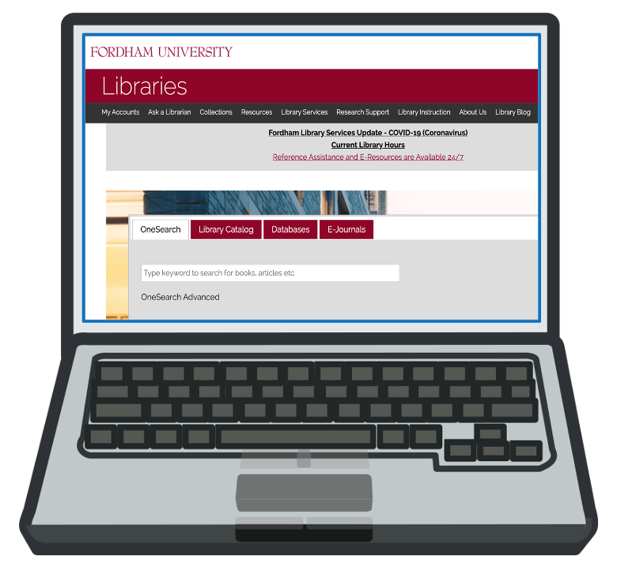
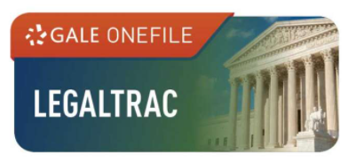
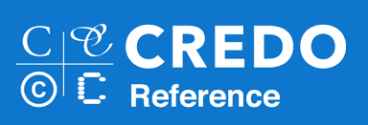
Introduction to Legal Research
Clipart via https://openclipart.org/

Slide 2
Welcome to Fordham University Libraries!
Today we are going to cover basic legal research with the following steps:
Choosing and refining a research topic
Performing background research
Working with secondary and primary sources
Clipart via https://openclipart.org/

Slide 3
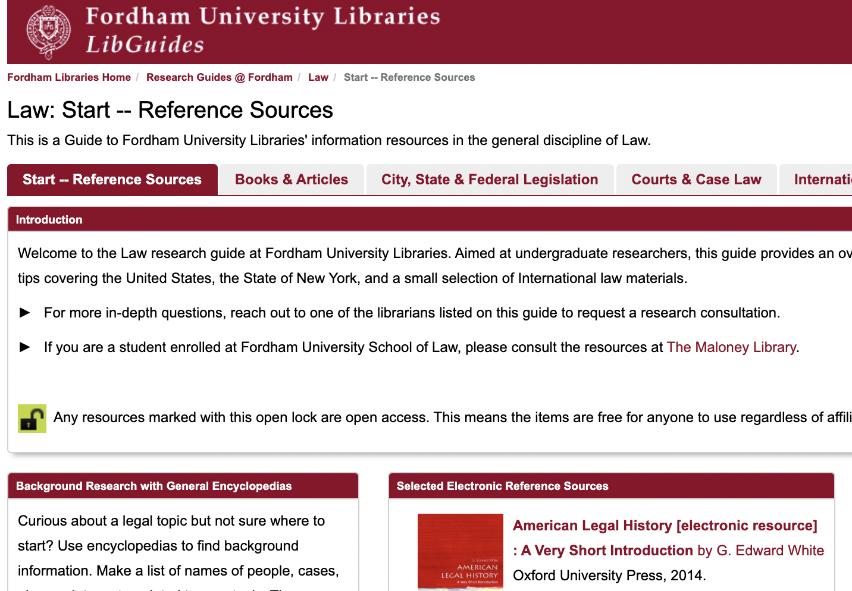
Law Research Guide: https://fordham.libguides.com/Law
Throughout this presentation, we will refer to Fordham Libraries' research guide on Law.
This guide offers an overview of proprietary resources purchased by Fordham & open access resources available to all online.

Slide 4
Legal research depends on the sources needed:
Primary sources are original sources that are binding such as Constitutions, Cases, Statutes, Regulations, etc. These items are usually organized by jurisdiction in databases.
Secondary sources present a point of view or offer summaries such as Commentaries, Law Reviews, Background Materials, Records, Briefs, etc.
Secondary sources are easier to read and understand than the primary sources. They typically cite sources that will help you find similar or additional secondary sources, and offer information about primary sources that will help you find them in an open government or library database.
Clipart via https://openclipart.org/

Slide 5
Getting Started with the LegalTrac Database
LegalTrac offers selective access to secondary sources including major law reviews, law journals, specialty law and bar association journals and legal newspapers well as coverage of federal and state cases, laws and regulations, legal practice and taxation, and international law.
Under Search Tools, let’s start our research using the Topic Finder:

Slide 6
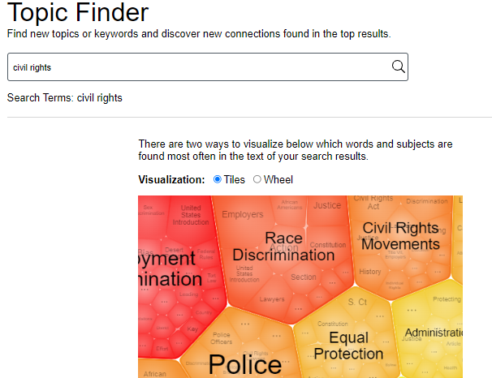
Sample search: Civil Rights
Click in the bubbles that interest you to focus your search further:

Slide 7
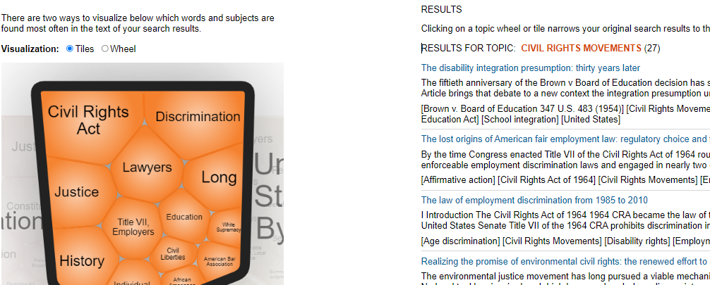
View Results
Keep clicking on bubbles to drill down further:

Slide 8
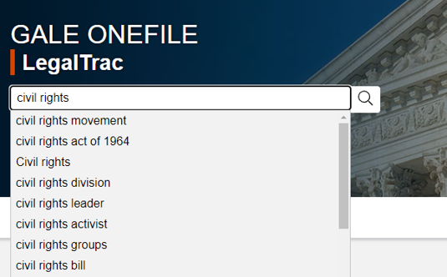
Searching by Keyword
If the image based format in Topic Finder does not suit your learning style, search by keyword instead:
As you type in your search terms, the database may suggest variations.
If one of the suggestions fits what you want to research, select those terms.
Once you press search and examine your results, you can refine from there with additional or different terms.

Slide 9
Additional tips for refining your legal topic:
Understand the facts – Examine the events and environments that required legal intervention. Online encyclopedias like Credo Reference or newspapers can help with background research.
Understand the context – Consider how and when a law was created, as well as its jurisdiction.
Understand the impact – Focus on how a law impacts an individual, class or group of people, event, place, etc.

Slide 10
Finding Primary Sources for Congressional Bills:
The jurisdiction of your legal topic will guide where to look for primary sources.
For example, to find the original text of the Civil Rights Act of 1964, we will need to look at Congressional resources.
Congress.gov (open access) provides information about bills, schedules, research reports, biographies, historical information, and more.
ProQuest Legislative Insight (library database) covers Congressional legislative history including enacted and related bills, Congressional Record excerpts, committee documents, and Presidential signing statements.

Slide 11
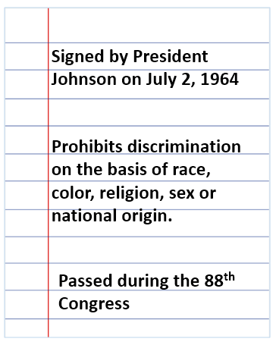
Let’s collect notes so we can find the Civil Rights Act of 1964:
What details could we add?

Slide 12
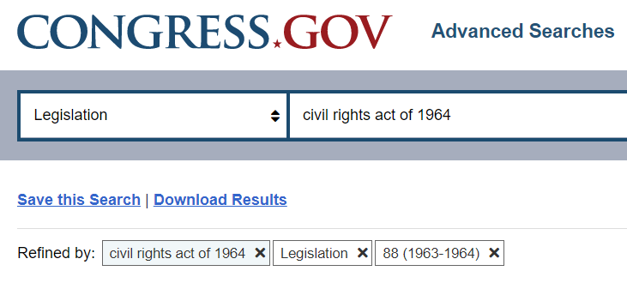
Let’s find the Civil Rights Act of 1964 on Congress.gov:
The details and context we collected in our notes will help our search (the title of the law, when it was passed, the Congressional session number, etc):

Slide 13
Finding Primary Sources for Supreme Court Cases
To find primary source documents from Supreme Court cases, we can use:
SupremeCourt.gov offering opinions, oral arguments, case documents, biographies of Supreme Court Justices, and more from 2014-present.
Oyez is a multimedia archive offering easy-to-read case summaries, searchable audio when available, illustrated decision information, and full-text Supreme Court opinions from 1789-present.

Slide 14
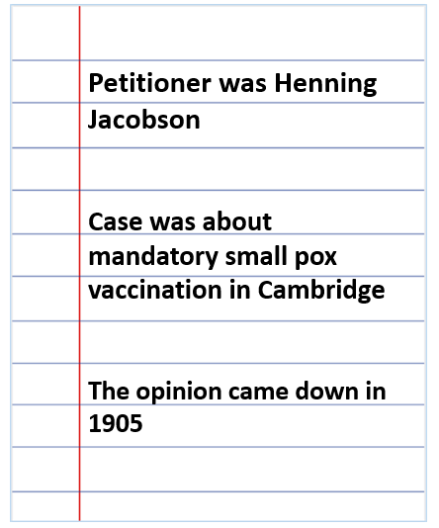
Let’s collect notes so we can find Jacobson v. Massachusetts:
What details could we add?

Slide 15
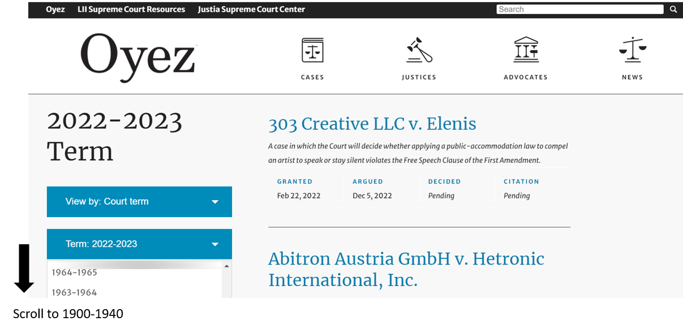
Let’s find Jacobson v. Massachusetts on Oyez:

Slide 16
Questions?
Try the following resources for help:
Law Research Guide
Law and Legal Resources at NYPL
Good luck with your research paper!
Tierney Gleason, Reference & Digital Humanities Librarian
tgleason11@fordham.edu
Clipart via https://openclipart.org/

