Slide 1
NUTR 495: Critical reading strategies
Carolyn Schubert

Slide 2
Re-thinking reading
Step 1
Read + dissect the pieces → Worksheet Template
Step 2
Read + critique → Quality Criteria Checklist

Slide 3
Re-thinking reading
Read out of order
Abstract > Introduction > Conclusions > Methods > Results > Discussion
Purpose & Relevance
Check for bias,
gaps, or flaws

Slide 4
Re-thinking reading activity
Identify
Research purpose(s)
Author conclusion(s)
Discuss your perspectives about
Would implementing the intervention result in improved outcomes?
Did the authors study a topic that patients would care about?
Is the focus a common issue of concern to dietetics practice?
Is the intervention feasible?

Slide 5
Examining the evidence about participants
Worksheet Template
QCC
Research Plans (Methods)
Inclusion Criteria
Exclusion Criteria
Recruitment (# asked)
Blinding
Research Reality (Results)
Sex, Ethnicity, Age
Other Demographics
Attrition (# participated)
Research Evaluation
Selection Bias (#2)
Comparable Groups (#3)
Withdrawals (#4)
Blinding (#5)

Slide 6
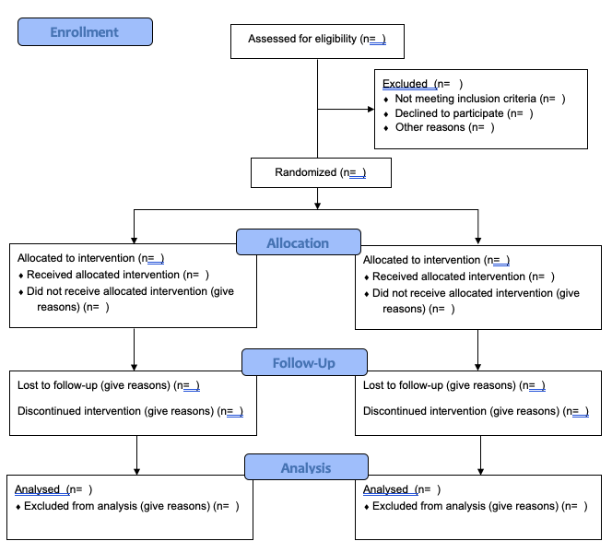
Consort Transparent reporting of trials

Slide 7
Examining the evidence about participants
Identify
Participant information in Methods & Results sections
Discuss*
Was the selection of study subjects free from bias? (QCC 2)
Were study groups comparable? (QCC 3
Was the method of handling withdrawals described well? (QCC 4)
Decide
Do you still trust this article? Why or why not?

Slide 8
Examining the evidence about Interventions
Worksheet Template
QCC
Research Plans (Methods)
Design
Intervention
Statistical Analysis
Data Collection
Research Reality (Results)
Summary of key findings
Research Evaluation
Intervention + variables (#6)
Outcome measures (#7)
Appropriate stats analysis (#8)

Slide 9
Data collection summary
Timing of Measurements | Dependent Variables | Independent Variables | Control Variables
Frequency of measurements | Things affected by change | Things making a change | Things we are keeping consistent across

Slide 10
Data collection summary example
 | Timing of Measurements | Dependent Variables | Independent Variables | Control Variables
 | Frequency of measurements | Things affected by change | Things making a change | Things consistent across
Intervention Interest | Cumulative interest over 6 weeks | Response to recruitment | Recruitment (Email, Flyer, In-Person)
Adherence | 2 weekly posts x 12 wks | Like and Seen by responses | Health Education posts | Facebook
Retention | Pre + Post | # of participants | Study duration | Length of study

Slide 11
Interventions Activity
Focus on Dietary Behaviors to answer the following:
Find the variables
Describe the timing for data collection
Choose the most accurate research design description
Identify the Statistical Analysis plan
Review results to see if the independent variable caused change
*If stuck, consult resources on Dietetics Research Guide > Evaluate Sources page

Slide 12
Interventions activity answers
Timing of Measurements | Dependent Variables | Independent Variables | Control Variables
Baseline: 3x 6-wk: 3x 12-wk: 3x Total: 9 recalls | Dietary behaviors as measured with ASA24 tool | Social media posts

Slide 13
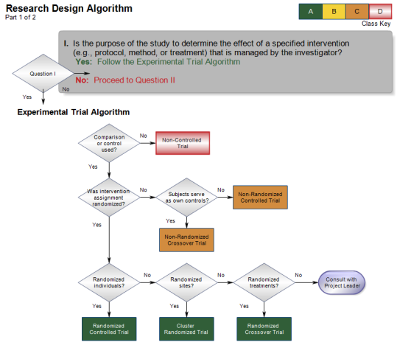
Interventions activity answers

Slide 14
Interventions activity answers
Descriptive Statistics, NOT Inferential
Change in mean percent
Table 3 - Means
 |  | Baseline | 6 weeks | 12 weeks
Daily Kcaloric consumption | Experimental | 1986.1 | 1971.7 | 1945.1
 | Comparison | 1953.4 | 1935.3 | 1810.1
Daily Vegetable | Experimental | 1.5 | 1.3 | 1.3
 | Comparison | 1.3 | 1.7 | 1.0

