Slide 1
Researching Laws & Legislation
A library workshop to learn how to find primary texts of laws and/or proposed legislation with a focus on Congress, the Supreme Court, Executive Orders, and state legislatures.
Presenter: Tierney Gleason, Adjunct Reference Librarian, tbg242@nyu.edu
NYU Libraries | March 1, 2023

Slide 2
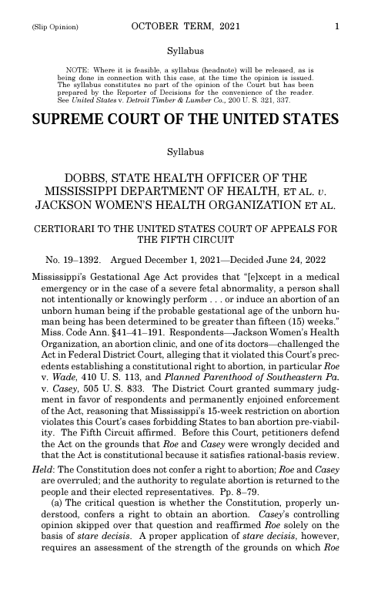
Learning Objectives:
How do I find the Dobbs decision?
Background research tips
Finding the original text of laws & legislative history from:
Congress
The Supreme Court
Executive Orders from the President
State-level legislation
Your questions & additional resources
Dobbs v. Jackson Women's Health Organization, 597 U.S. ___ (2022).

Slide 3
Background Research Tips

Slide 4
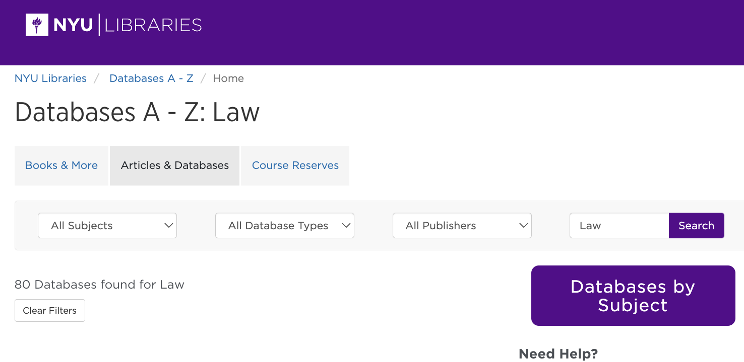
There are many databases covering the law…
…but only specific resources hold primary sources.

Slide 5
Gather background information to find laws
This could include:
The jurisdiction (Congress, Supreme Court, Executive branch, State)
Who introduced the law or any of the parties involved
The status (was the law introduced, passed, vetoed, referred to a committee, etc)
When the law was introduced or passed
Any bill numbers if available
Any information about the events or environments that inspired legal intervention
→ Notes taken from newspapers, online encyclopedias, websites, articles, books, and more provide the keywords and limiters you will need to search databases.

Slide 6
Background information is key
It defines where you will search by jurisdiction.
It provides keywords and context for navigating a range of databases or web resources where the overall search functionality and database limiters may vary.
Many laws are in conversation with other laws; knowing the general dates and parties involved will help locate the specific law you need.
Laws follow citation and style that differs from how we talk about them in everyday speech.

Slide 7
Congress

Slide 8
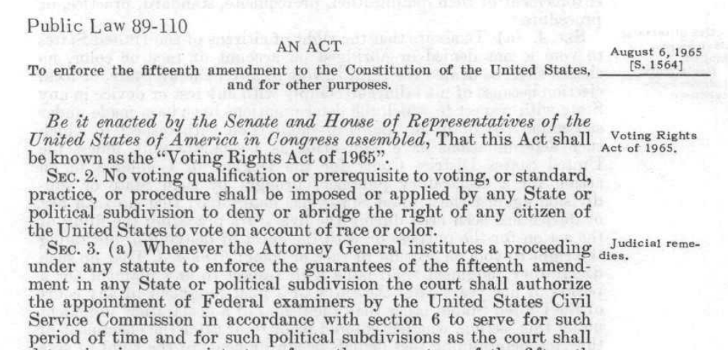
Finding Congressional Bills:
Best bet databases to search:
Open access: Congress.gov (from 1799 to present)
Library databases: ProQuest Congressional or Legislative Insight
Screenshot from: Congress.gov. "S.1564 - 89th Congress (1965-1966): An Act to enforce the 15th amendment to the Constitution of the United States." August 6, 1965. https://www.congress.gov/bill/89th-congress/senate-bill/1564.

Slide 9
The Supreme Court

Slide 10
Finding Supreme Court Cases:
Best bet resources:
Open access: SupremeCourt.gov (2014 to present)
Library databases: Supreme Court Insight
Resources with additional primary source content relating to cases:
Open access: Oyez
Library databases: HeinOnline or Making of Modern Law: U.S. Supreme Court Records and Briefs, 1832-1978

Slide 11
Listening to Supreme Court Oral Arguments Live:
Best bet open access resources:
SupremeCourt.gov
C-SPAN (Content note: Offers live, searchable transcripts of oral arguments. Allows users to create clips and share them with a specific url and/or linking to Twitter & Facebook.)

Slide 12
Executive Orders

Slide 13
Finding Executive Orders:
Best bet databases to search:
Open access: Federal Register, Executive Orders
Library databases: ProQuest Regulatory Insight

Slide 14
State Legislatures

Slide 15
Proposed Bills & Enacted Laws by State
Open access options/examples:
New York
Open educational resource: Law 101: Fundamentals of Law, New York and Federal Law
Florida
Texas
California
LegiScan “freemium” service enabling searching legislation across many states
Library database: Find archived session laws by state in HeinOnline under Browse Databases by Category → U.S. State Content → Session Laws Library → State Session Laws → select state or U.S. territory of interest.

Slide 16
Look for organizations & activists tracking legislation by state on specific topics:
Examples:
“Map: Where Critical Race Theory Is Under Attack” from Education Week.
“March Anti-Trans Legislative Risk Map” by Erin Reed.
Sometimes organizations do not have the most current information posted. Check government websites for the most current information.

Slide 17
Questions & Further Resources

Slide 18
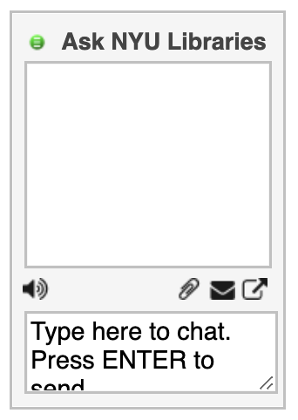
We hope this workshop was helpful!
For further resources, try the following:
Chat with us to get research help via Ask NYU Libraries
Explore the resources on the Legal Studies research guide.
Take a deeper dive into the Help resources from HeinOnline including videos and LibGuides covering specific aspects of legal research.

