Slide 1
Finding and Entering Conversations in your Research:
Using synthesis to discover what your sources say
Notes:
Librarian introduces herself briefly

Slide 2
You enter a parlor…
The original research conversation you have to explore.
“Imagine that you enter a parlor. You come late. When you arrive, others have long preceded you, and they are engaged in a heated discussion, a discussion too heated for them to pause and tell you exactly what it is about. In fact, the discussion had already begun long before any of them got there, so that no one present is qualified to retrace for you all the steps that had gone before. You listen for a while, until you decide that you have caught the tenor of the argument; then you put in your oar. Someone answers; you answer him; another comes to your defense… However, the discussion is interminable. The hour grows late, you must depart. And you do depart, with the discussion still vigorously in progress.”
Kenneth Burke, The Philosophy of Literary Form,110-111
Your Voice
The voices responding to your work.
Notes:
Establish the metaphor of research as a conversation – synthesis

Slide 3
Synthesis
Synthesis gathers & pieces information together to create a new conversation
Notes:
Librarian introduces synthesis by asking the class, “Tell me what comes to mind when you think of synthesis.”
Get a few responses from students,
Click to bring bullet points up
Compare synthesis to photosynthesis

Slide 4
What Synthesis is NOT
Just summarizing someone else
Critiquing a source
Comparing & contrasting sources
Lots of direct quoting without using your own voice
Notes:
Synthesis is not summary, critique, classification, compare & contrast, or quotes with no commentary

Slide 5
What Synthesis DOES
Require critical thought.
Focus on ideas, not just on summary or quotation.
Use information and sources to make your own point
Identify conversations
Analyze and combine multiple sources in a meaningful way
Notes:
Synthesis is using conversations in the literature to make a point, thinking beyond the text, inferring relationships amongst different sources, presenting own point of view and analyzing, combining information in a meaningful way.

Slide 6
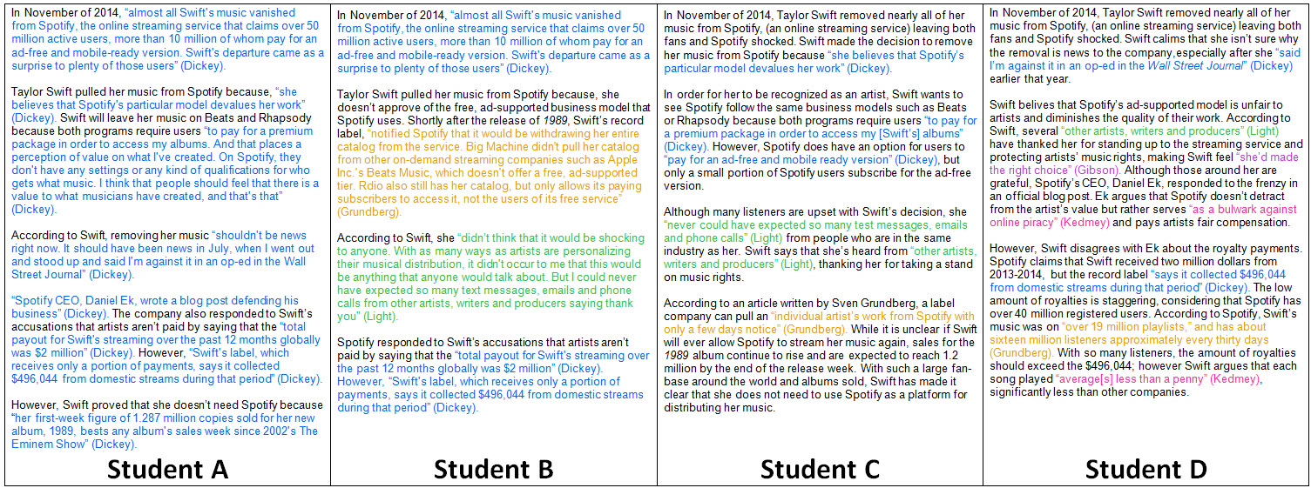
Visualizing Synthesis
Comparison of papers from 4 students:
Notes:
Show the comparison of papers and ask the class, “Based on what we just discussed, which paper is a good example of synthesis? Why?”

Slide 7
The role of synthesis
Synthesis is about seeing how all the sources talk to each other (learning the conversation)
It determines how you engage in response to your sources
Notes:
As seen in the example above, synthesis is all about seeing how our sources converse with each other.
Ask the class, “How do we do this? Tell me how we synthesize information and make connections between sources.” Get a few responses from the class, prompt them if necessary by offering suggestions such as, annotation, reading, summarizing, writing notes, identifying main points, critical thinking, etc.
How do we determine which conversations are important to address?
How do we go about grouping these conversations?

Slide 8
It’s a Process
Notes:
This is a process. You can’t go from pile of research to paper. Writers who don’t engage in this paper produce things that either don’t say anything new and just reiterate what others say, or that try to smash sources together where they don’t belong. This just makes people confused and less likely to listen to what you’re trying to say.

Slide 9
Research Matrix
Encourages synthesis by forcing you to group idea by idea, not source by source.
Helps you see how your sources’ ideas would mix and mingle in conversation.
Looks simple, but is quite messy. You will probably go through a few iterations of your matrix.

Slide 10
What does it look like?
Notes:
Here is an example of a synthesis matrix. At the top we see the different sources and on the side we see the main points brought up.
If you find that only one source talks about a certain main point what might that indicate to you as a researcher?
The way you frame these conversations allows you to enter them – thereby creating new knowledge.
Once you know how your sources talk to each other, the next step in the synthesis matrix is inserting your voice into the conversation. Your voice, analysis, opinion, commentary provides context for your research and also helps your reader see the same connections you do.

Slide 11
How to begin?
Read your sources carefully and find the main idea(s) of each source
Look for similarities in your sources – which sources are talking about the same main ideas? (for example, sources that discuss the historical background on your topic)

Slide 12
Your Turn
My Topic is ______________________________________________________
Main Ideas | Source 1 | Source 2 | Source 3… | My Thoughts
Main Idea 1
Main Idea 2
Main Idea 3…

Slide 13
Good Luck!
And don’t forget, you have a librarian whose job it is to help you with all this. Let us know how we can help!

