Slide 1
Digital Politics – Election 2016 Dr. Jason Jarvis Loyola Marymount University

Slide 2
Digital politics – Election 2016
Social media rules –
Trump is a Twitter Master
Rhetorical Tools:
Metaphors
Enthymemes
Texts:
Trump Twitter Feed
Trump Acceptance Speech
Notes:
Trump acceptance speech
https://www.youtube.com/watch?v=owuq_An4cnk

Slide 3
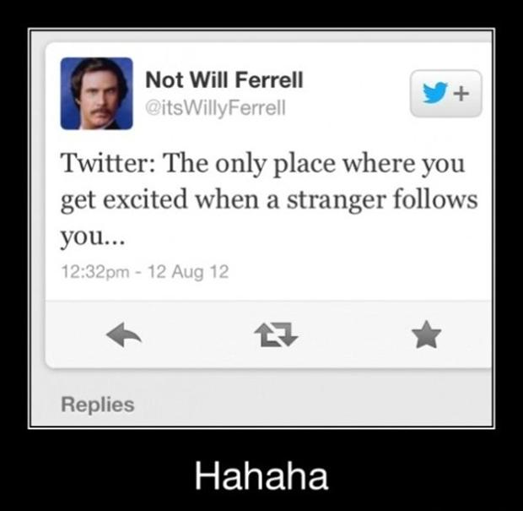
Twitter – A brief overview
Created: 2006
Founders: Jack Dorsey, Noah Glass, Biz Stone and Evan Williams
310 million regular users (March 2016)
At least 5% of accounts are bots – roughly 20 million – programmed to follow, Tweet and re-Tweet
Election day: 40 million tweets by 10 pm
140 characters – Twitter relies on enthymemes and metaphors
Notes:
10 things you don’t know about Twitter
https://www.youtube.com/watch?v=0-VLNiEbDRo

Slide 4
2 parts to a metaphor
A metaphor is a figure of speech that refers to one thing by mentioning another thing.
1) Tenor:
The topic or subject that is being explained
OFTEN IMPLIED and not explicit
2) Vehicle:
Mechanism or the lens being applied to the subject
Example:
Tenor:
Piglet/Baby pig
Vehicle:
Plant/Seed

Slide 5
~ Metaphors are important because ~>
Metaphors are usually wrong
They do not describe the actual world, they draw comparisons
The metaphors we use imply a particular view of the world ~
Example:
Life’s a beach
Life is hell
Why did the speaker choose the tenor and vehicle?
What does this tell us about the MOTIVES of the speaker?
Notes:
Metaphors explained
https://www.youtube.com/watch?v=A0edKgL9EgM

Slide 6
~Examples of metaphors~
The world is a vampire
The world is my oyster
“Time is money”
“War is hell”
“Men are dogs”

Slide 7
Rhetoric and reality – John Oliver explains the “swarm”
Notes:
John Oliver – The rhetoric of swarm (first 3 ½ minutes)
https://www.youtube.com/watch?v=umqvYhb3wf4

Slide 8
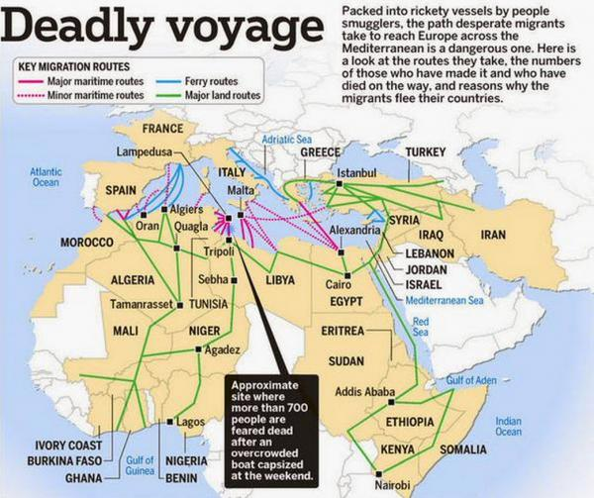
Metaphor practice: “Refugee” vs. “Swarm”
“A migrant swarm is coming to Europe”
Vs.
“Thousands of refugees are fleeing to Europe”

Slide 9
Rhetorical tools 1: Enthymemes
Enthymeme:
a form of argument in which at least one premise remains unstated.
Enthymemes invite the audience to fill in the blank, and complete the argument. The audience helps to create the argument.
Enthymemes create intimacy between speaker and audience
Enthymemes encourage the audience to trust a speaker, b/c every audience member will read their own experiences into the speaker.
Notes:
Trump is a ------: White House hopeful plays fill-in-the-blanks with voters
http://www.reuters.com/article/us-usa-election-trump-language-idUSKCN0VQ035

Slide 10
Enthymeme Practice
"With a name like Smucker's, it has to be good.“
“She could not have committed this awful crime. I have known here since she was a child.”
"Now, I don't know or have never met my candidate; and for that reason I am more apt to say something good of him than anyone else.“ – Will Rogers
“The gloves did not fit. If it doesn’t fit, you must acquit.” – Johnny Cochran

Slide 11
Enthymeme practice: President Elect Trump means _____?
1) On Muslims:
"I talked about Muslims," he said. "We have to have a temporary something, because there's something going on that's not good.“
2) On China: <Fill in the Blank>
"They've taken our jobs, they've taken our base, they've taken our money, and I love China, they get along great with me, I told you I have all these people, I do business with China, they agree with me. They can't: ________?________."

